Slide 1

Comal Trinity
Groundwater Conservation District
General Manager Report
May 18th 2026

Slide 2
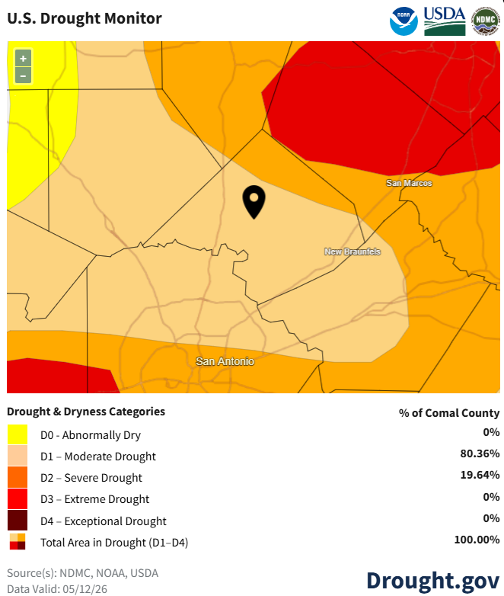
Comal County Drought Information- May 2026
Comal County Drought Information- August 2025

Slide 3
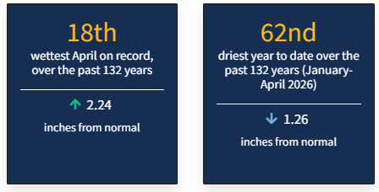
Comal County Drought Statistics April 2026

Slide 4
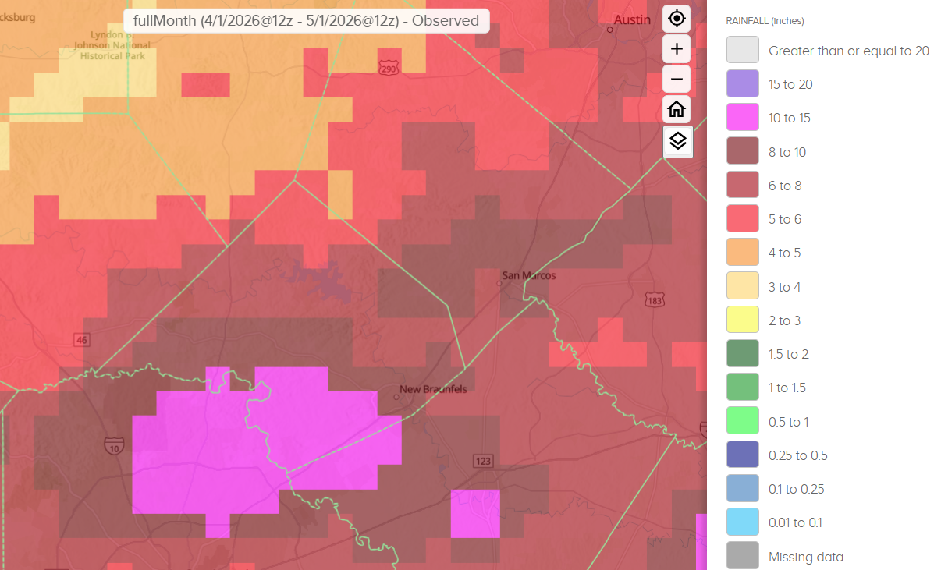
30 Day Observed Precipitation
4/1/2026 – 5/1/2026
4.0 to 15.0 Inches

Slide 5
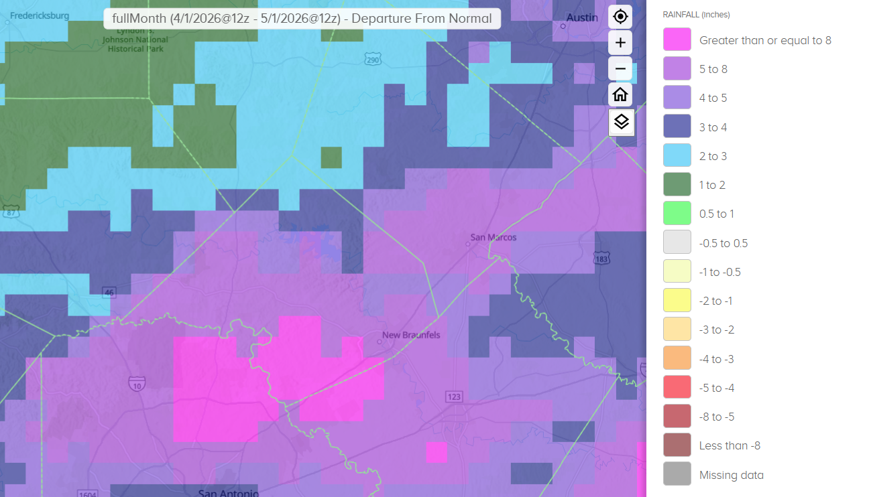
30 Day Precipitation Departure From Normal
4/1/2026 – 5/1/2026
2.0 to Greater than or Equal to 8.0 Inches

Slide 6
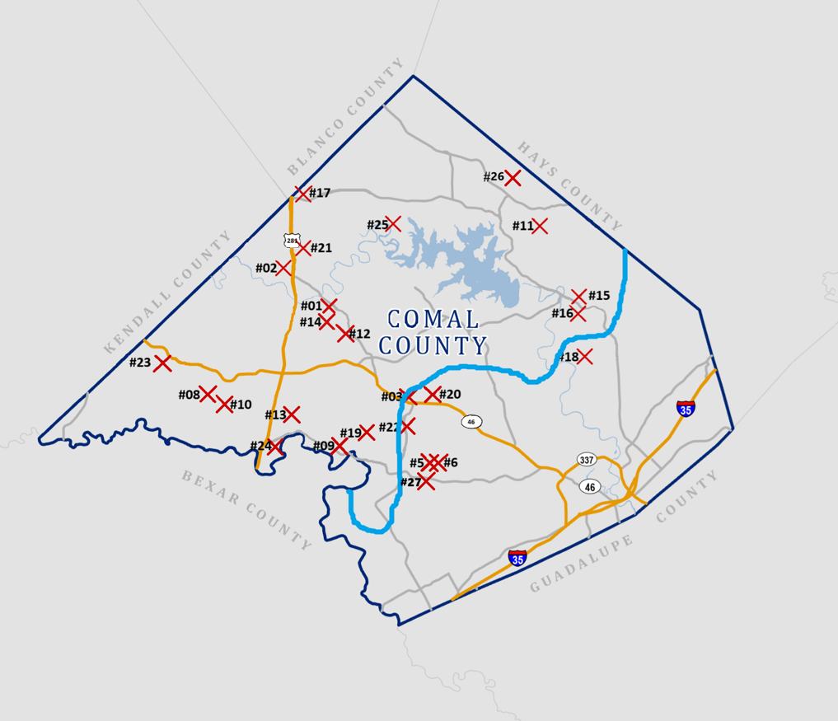

Slide 7
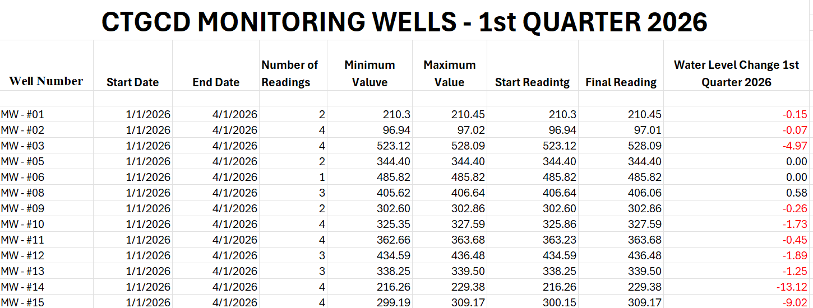

Slide 8
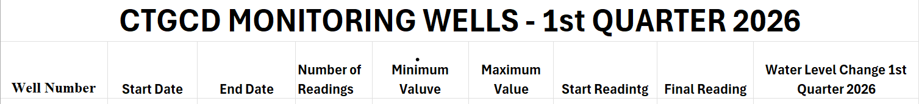
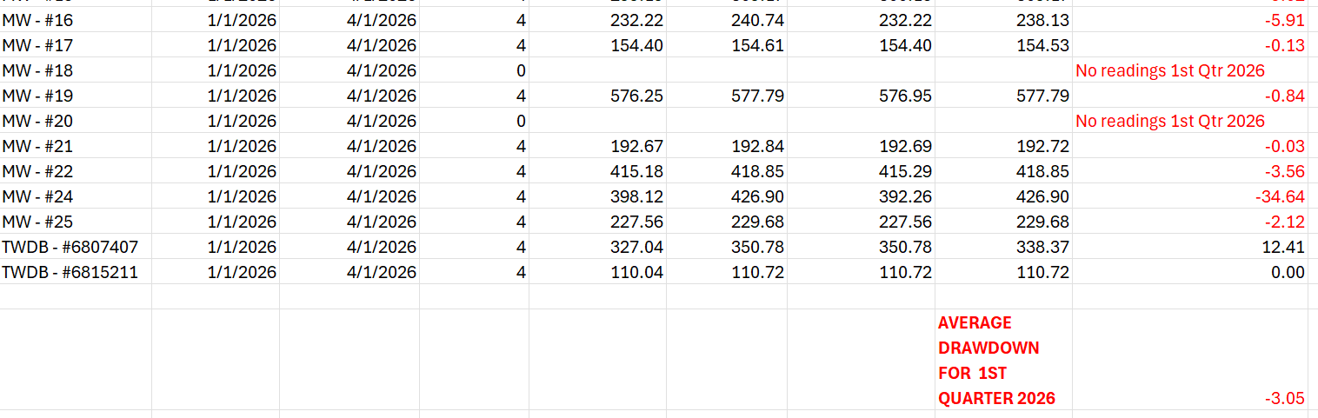

Slide 9
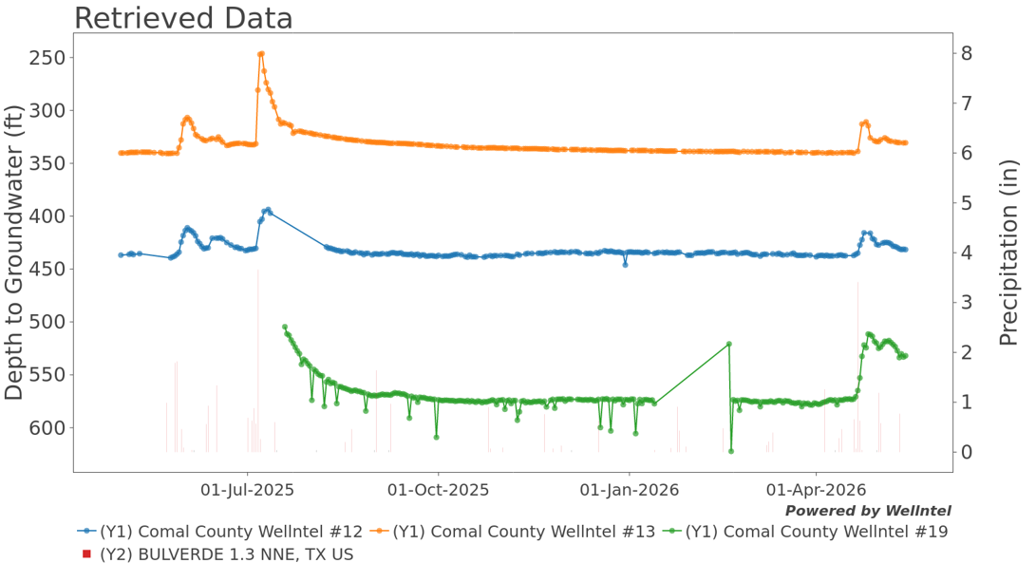

Slide 10
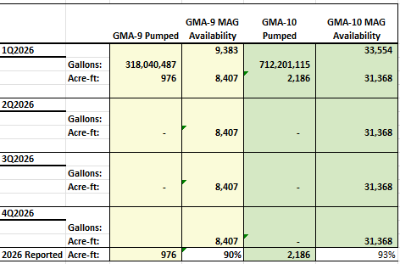

Slide 11

Well Applications By Type
Type of Application
a) Domestic | 18 |  |  |  | 18 | 14 | 4
a)S Livestock | 4 |  |  |  | 4 | 4
a)L Domestic Landscape Irrigation | 0 |  |  |  | 0
b) < 25,000 GPD (Non-exempt) | 1 |  |  |  | 1 | 1
c) > 25,000 GPD (Non-exempt) | 0 |  |  |  | 0
d) Plugging | 1 |  |  |  | 1 | 1
e) Test Bore | 2 |  |  |  | 2 | 2
f) Completion of test < 25,000 GPD | 0 |  |  |  | 0
g) Completion of test > 25,000 GPD | 0 |  |  |  | 0
Geothermal | 0 |  |  |  | 0
Monitor well | 0 |  |  |  | 0
1st Quarter 2026
2nd Quarter 2026
3rd Quarter 2026
4th Quarter 2026
Total for Year
GMA-9
GMA-10

Slide 12
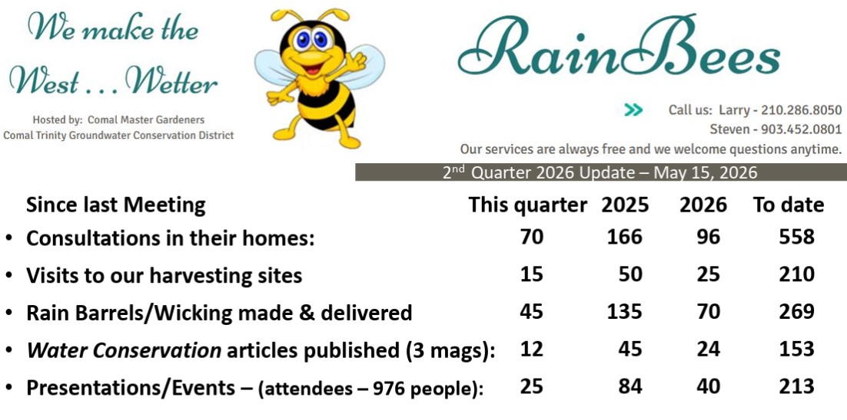

Slide 13
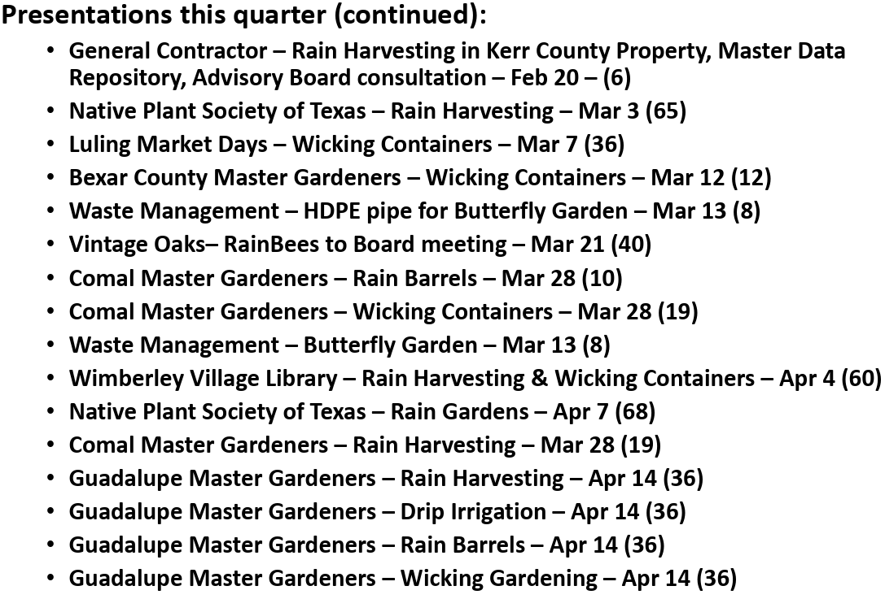

Slide 14
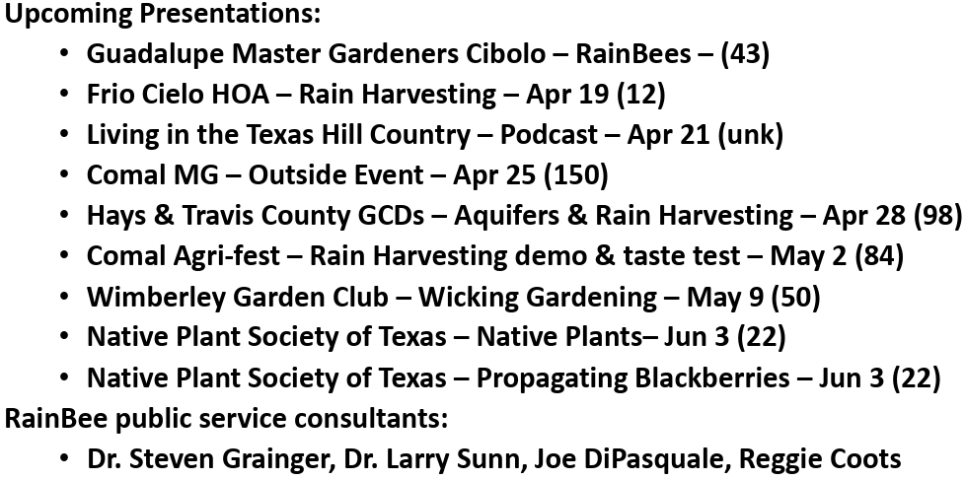

Slide 15
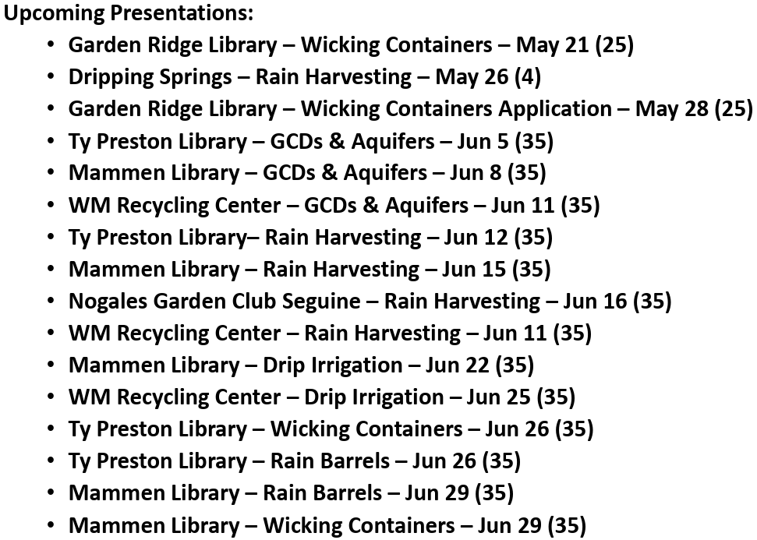

Slide 16
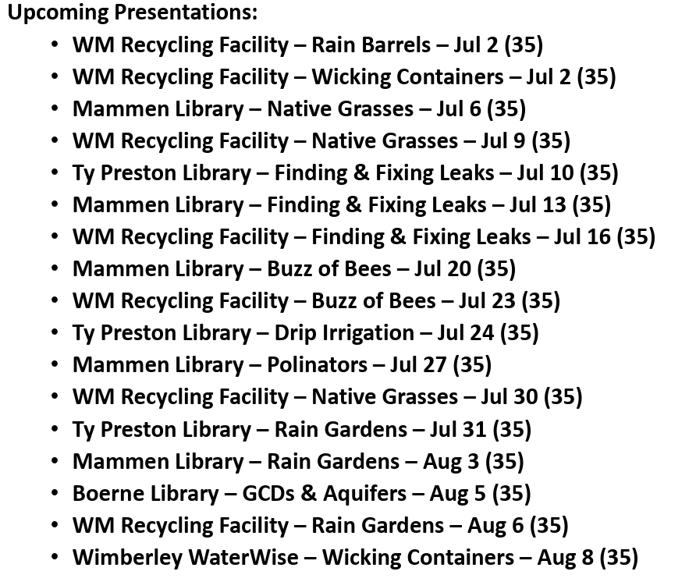

Slide 17
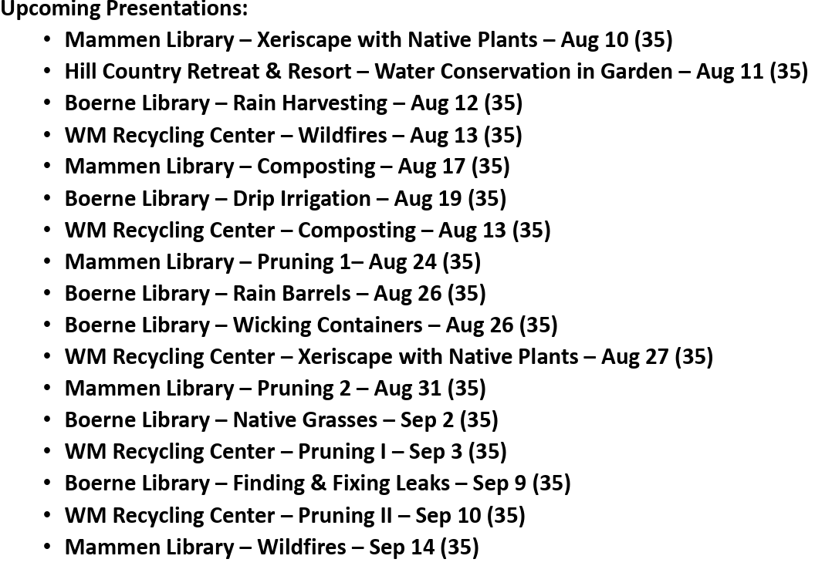

Slide 18
