Slide 1

Comal Trinity
Groundwater Conservation District
General Manager Report
November 17th 2025

Slide 2
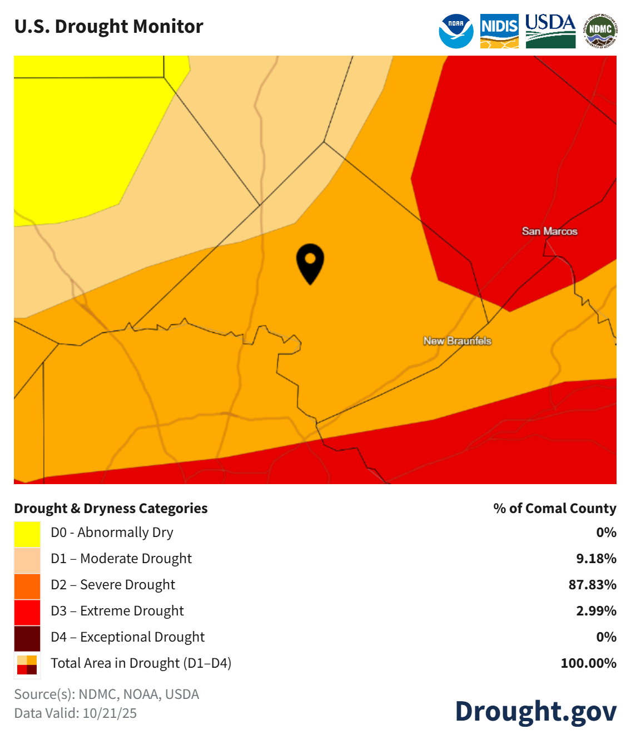
Comal County Drought Information- October 2025
Comal County Drought Information- August 2025

Slide 3
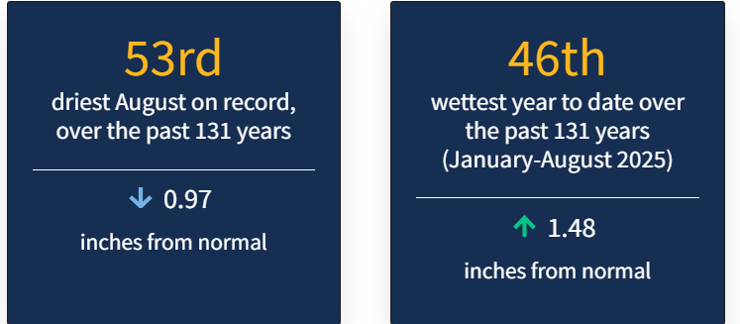
Comal County Drought Statistics August 2025

Slide 4
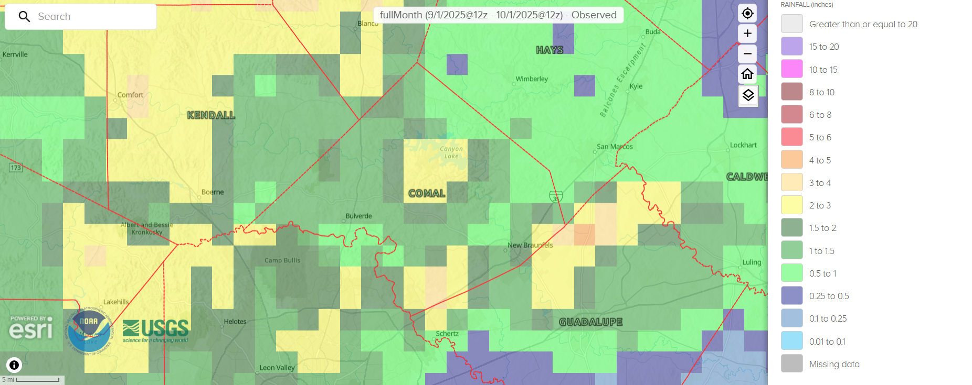
30 Day Observed Precipitation
9/1/2025 – 10/1/2025
0.5 to 4.0 Inches

Slide 5
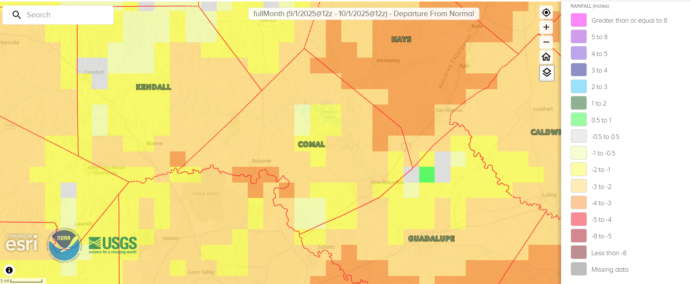
30 Day Precipitation Departure From Normal
9/1/2025 – 10/1/2025
-3.0 to Greater than or Equal to -0.5 Inches

Slide 6
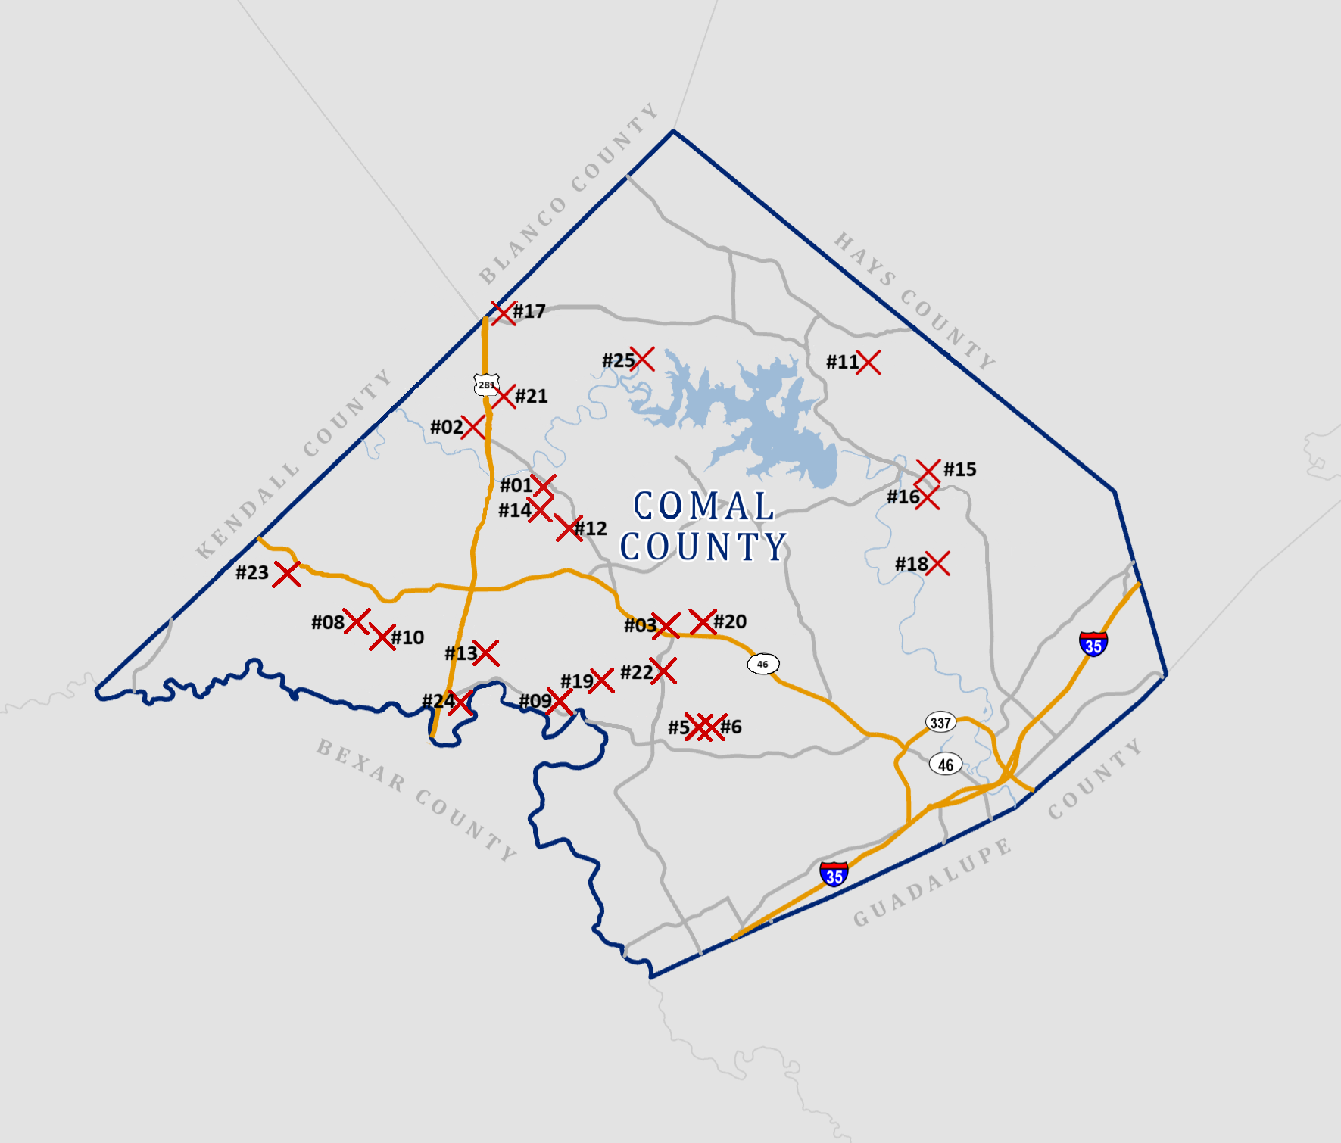

Slide 7
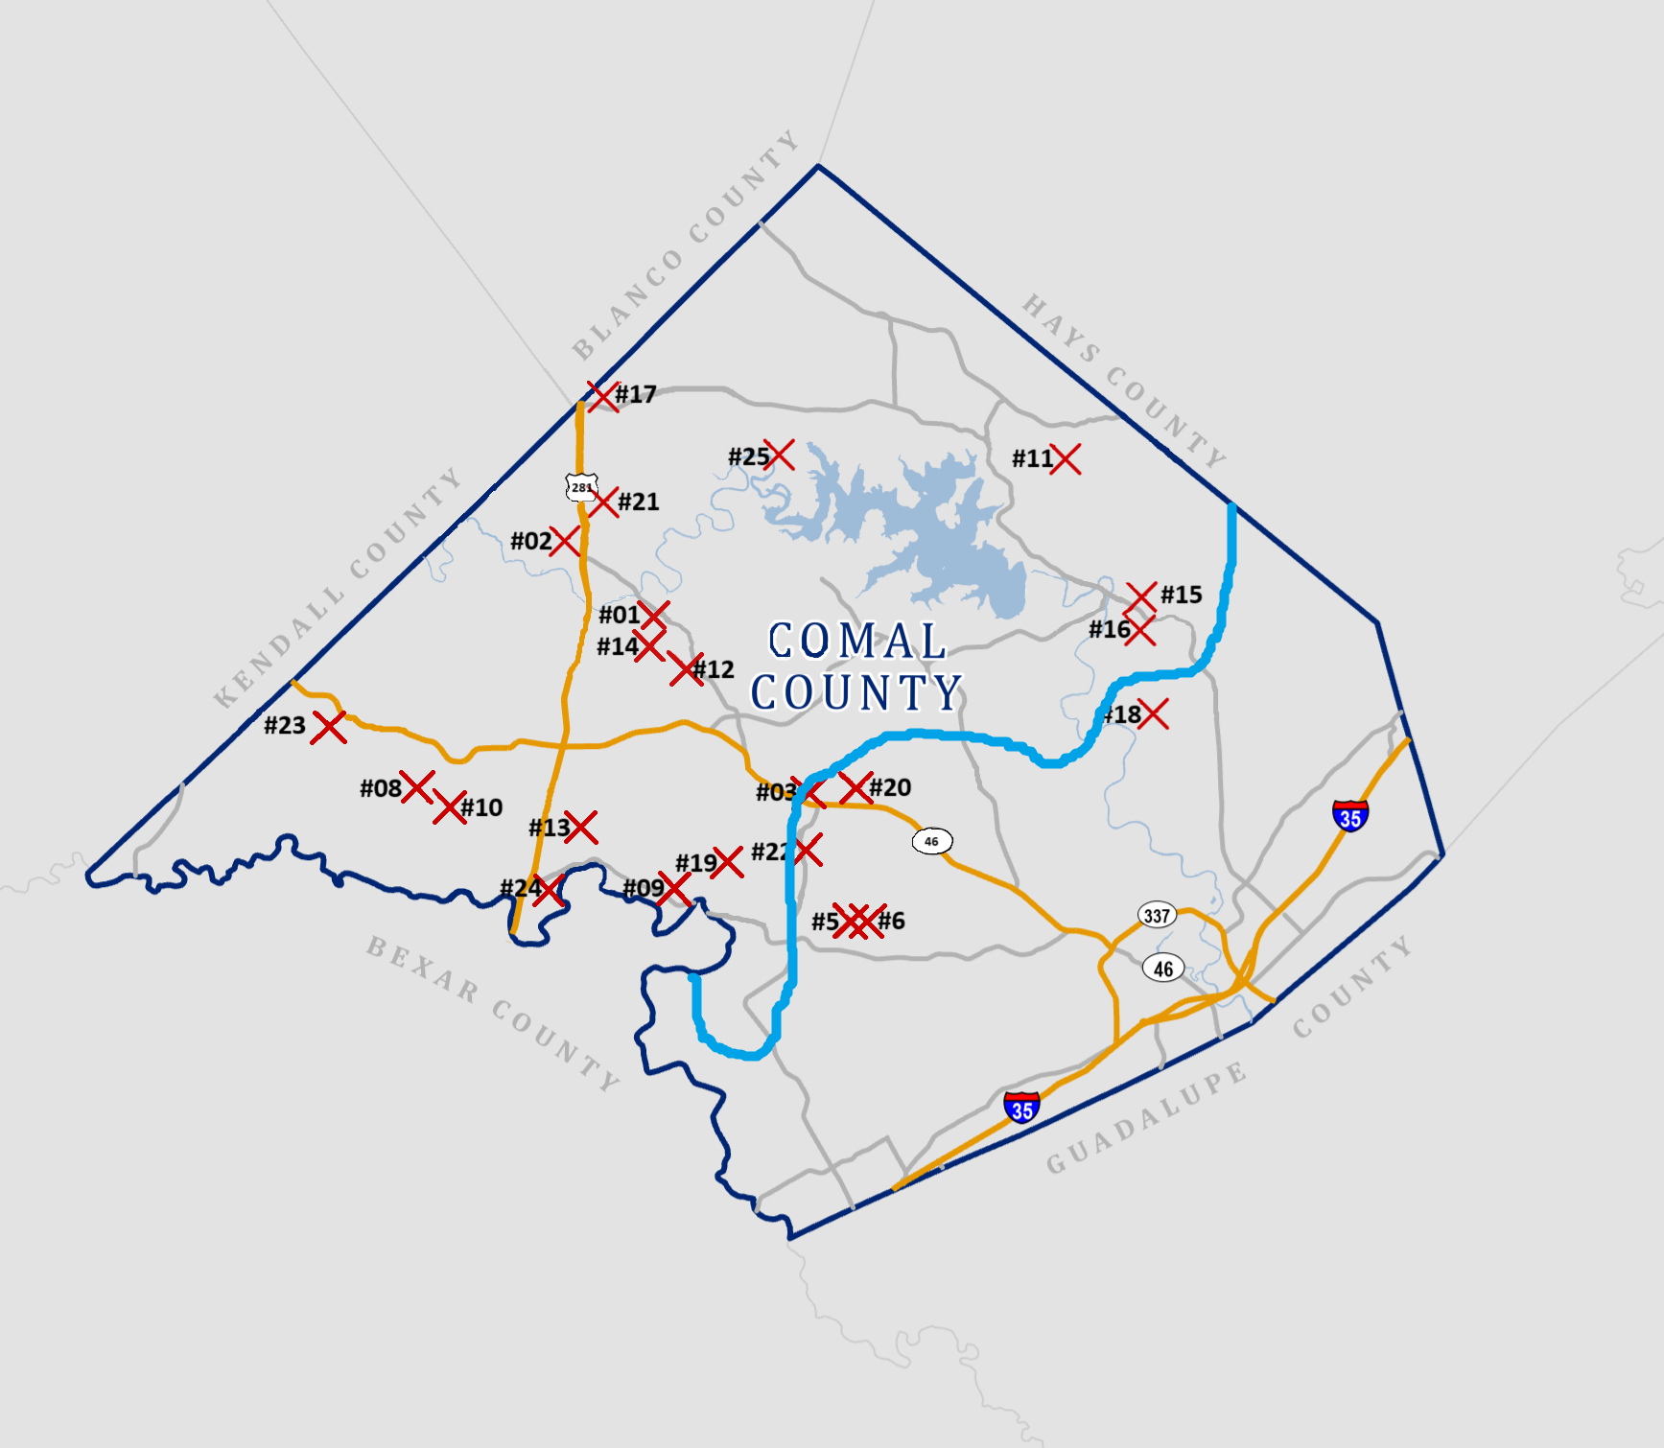
Groundwater Management Area #9
Groundwater Management Area #10

Slide 8
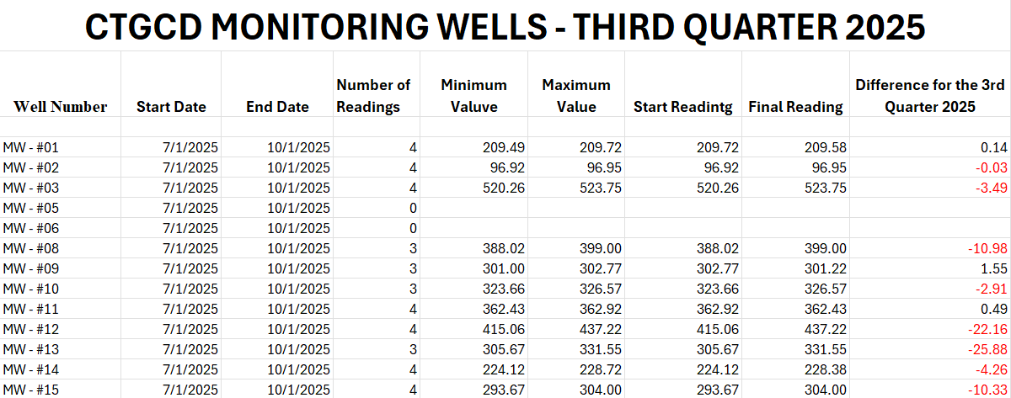

Slide 9
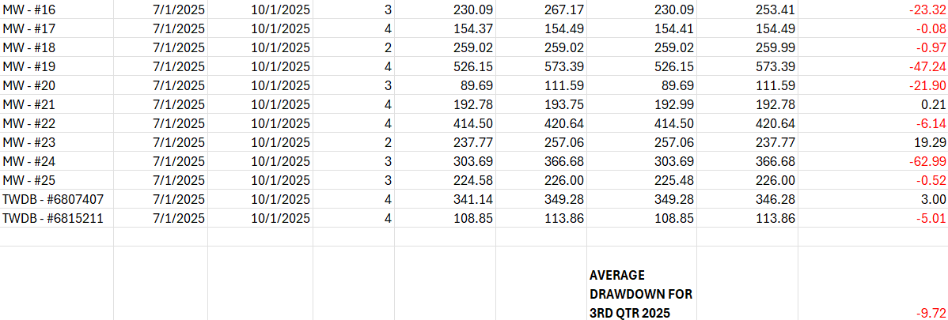
Third Quarter 2025 Months In-Service Well Monitoring

Slide 10
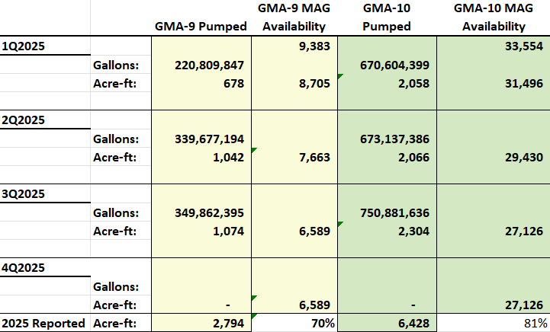

Slide 11

Well Applications By Type 2nd Qtr 2025
Type of Application | 1st Quarter | 2nd Quarter | 3rd Quarter | 4th Quarter | Total for Year | GMA 9 | GMA10
a) Domestic | 32 | 17 | 22 |  | 71 | 61 | 10
a)S Livestock | 1 | 0 | 1 |  | 2 | 0 | 2
a)L Domestic Landscape Irrigation | 2 | 4 | 0 |  | 6 | 5 | 1
b) < 25,000 GPD (Non-exempt) | 3 | 1 | 1 |  | 5 | 3 | 2
c) > 25,000 GPD (Non-exempt) | 0 | 0 | 0 |  | 0 | 0 | 0
d) Plugging | 3 | 2 | 4 |  | 9 | 5 | 4
e) Test Bore | 0 | 5 | 1 |  | 6 | 4 | 2
f) Completion of test < 25,000 GPD | 0 | 0 |  |  | 0
g) Completion of test > 25,000 GPD | 0 | 0 | 1 |  | 1 |  | 1
Geothermal | 0 | 0 |  |  | 0
Monitor well | 0 | 0 |  |  | 0

Slide 13
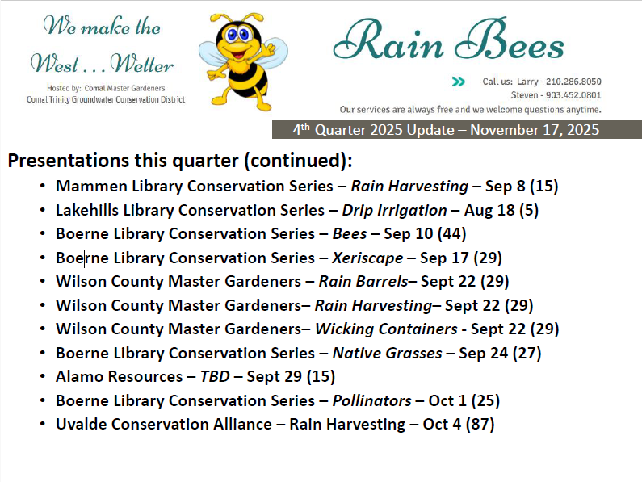

Slide 14
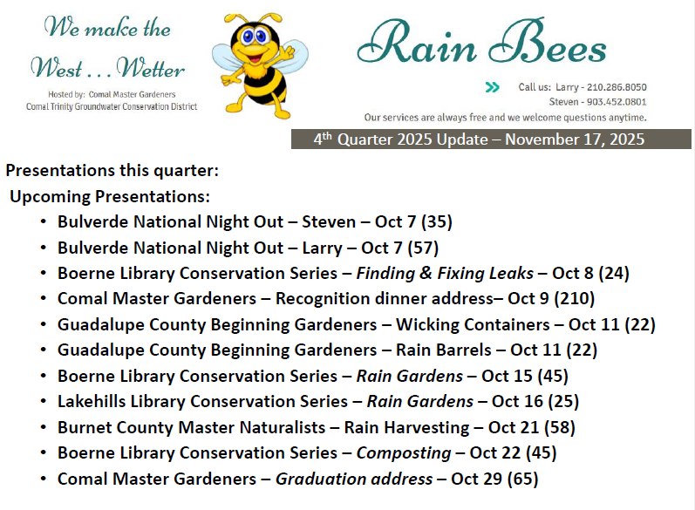

Slide 15
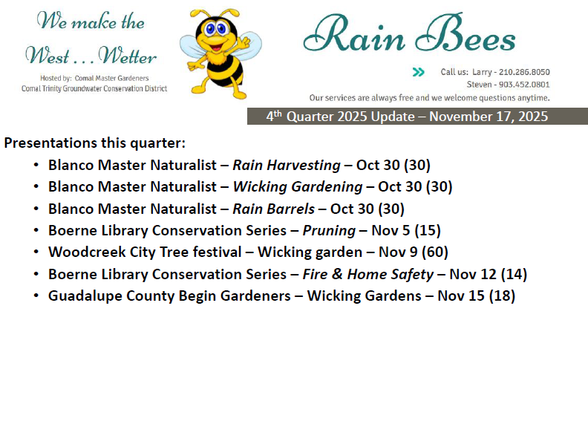

Slide 16
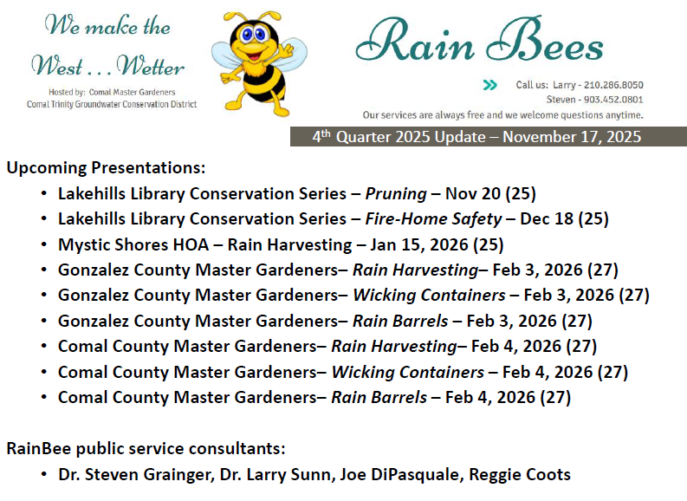

Slide 17
