Slide 1

Comal Trinity
Groundwater Conservation District
General Manager Report Workshop Meeting
November 17th 2025

Slide 2
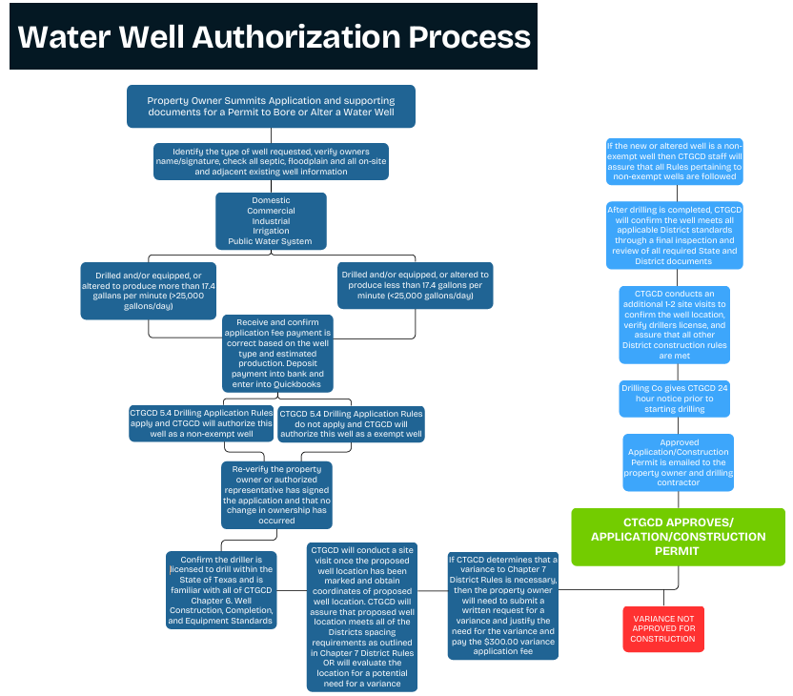

Slide 3
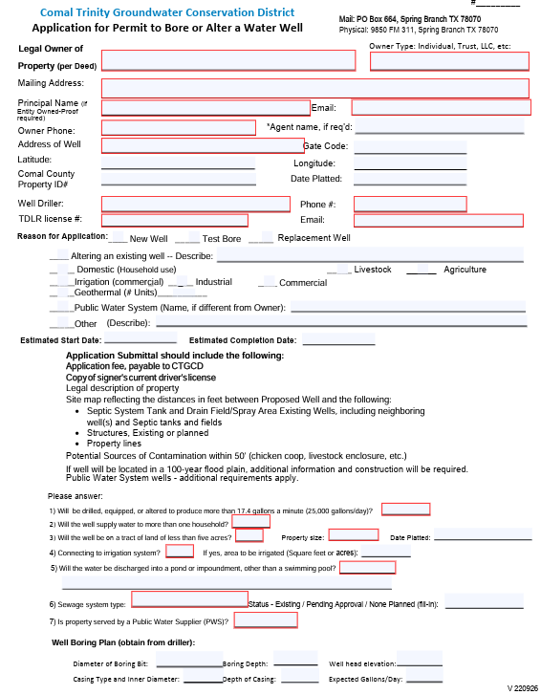
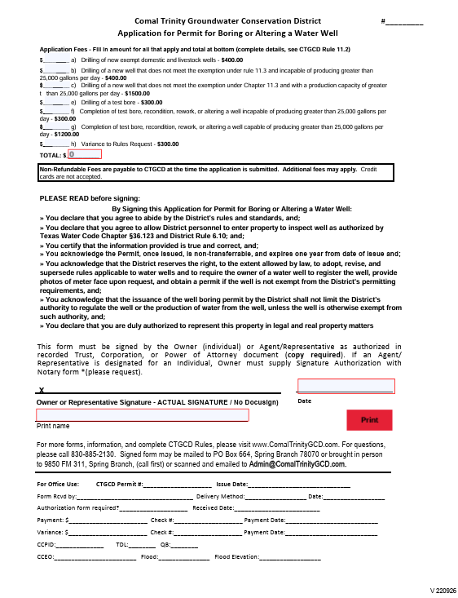

Slide 4
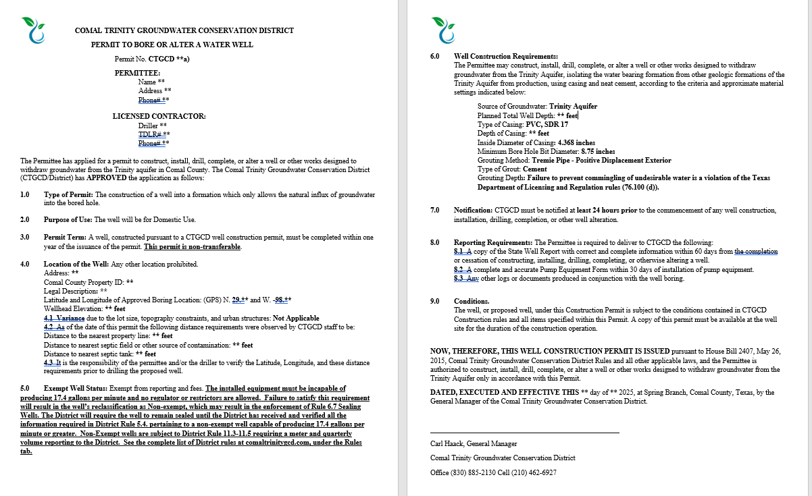

Slide 5
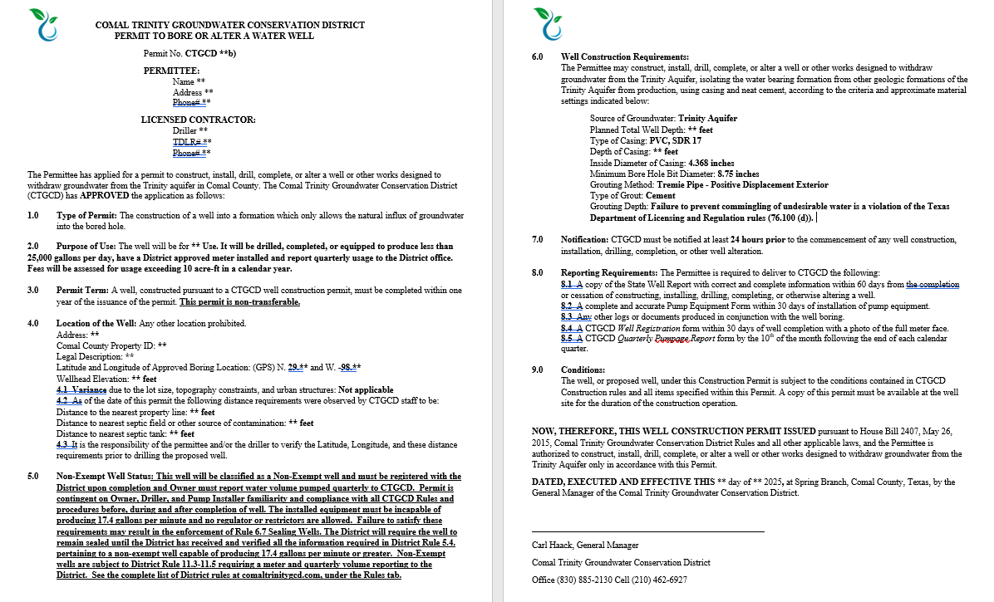

Slide 6
