Slide 1

Comal Trinity
Groundwater Conservation District
General Manager Report
February 23rd 2026

Slide 2
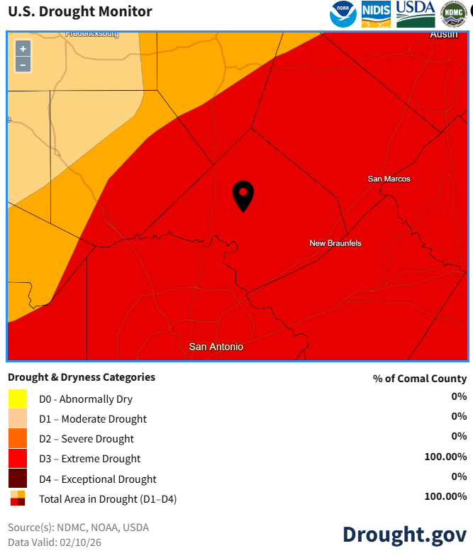
Comal County Drought Information- February 2026
Comal County Drought Information- August 2025

Slide 3
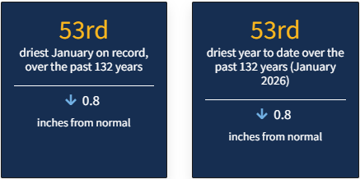
Comal County Drought Statistics January 2026

Slide 4
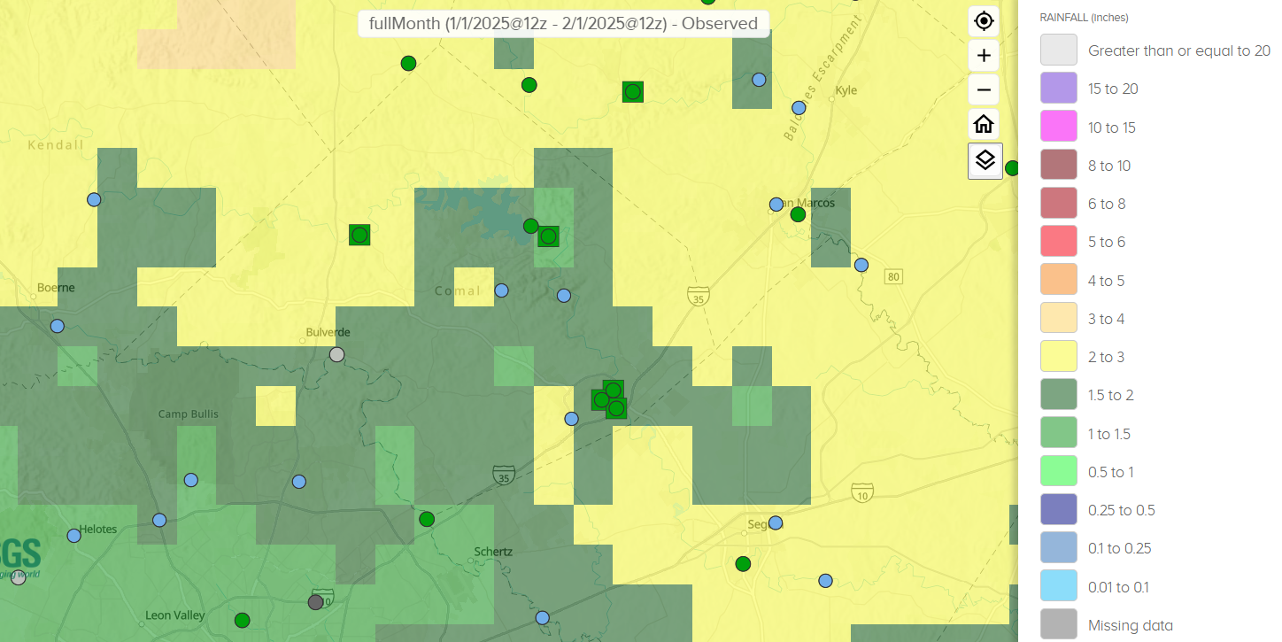
30 Day Observed Precipitation
1/1/2026 – 2/1/2026
0.5 to 3 Inches

Slide 5
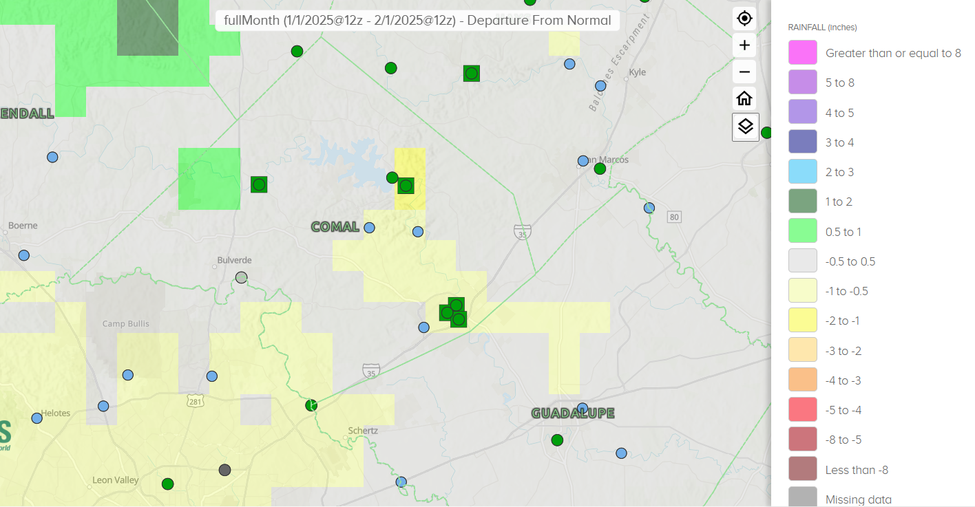
30 Day Precipitation Departure From Normal
1/1/2026 – 2/1/2026
-2.0 to Greater than or Equal to 1 Inches

Slide 6
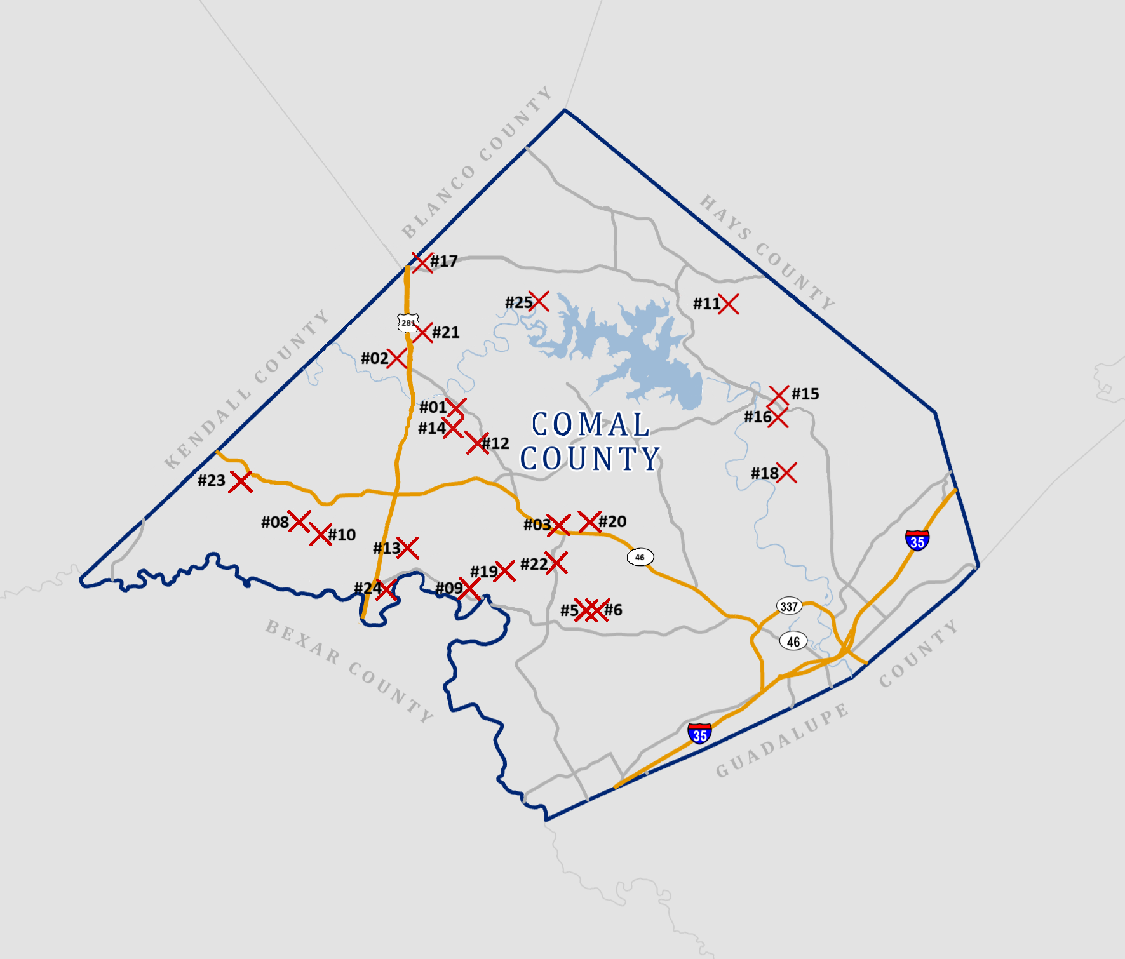

Slide 7
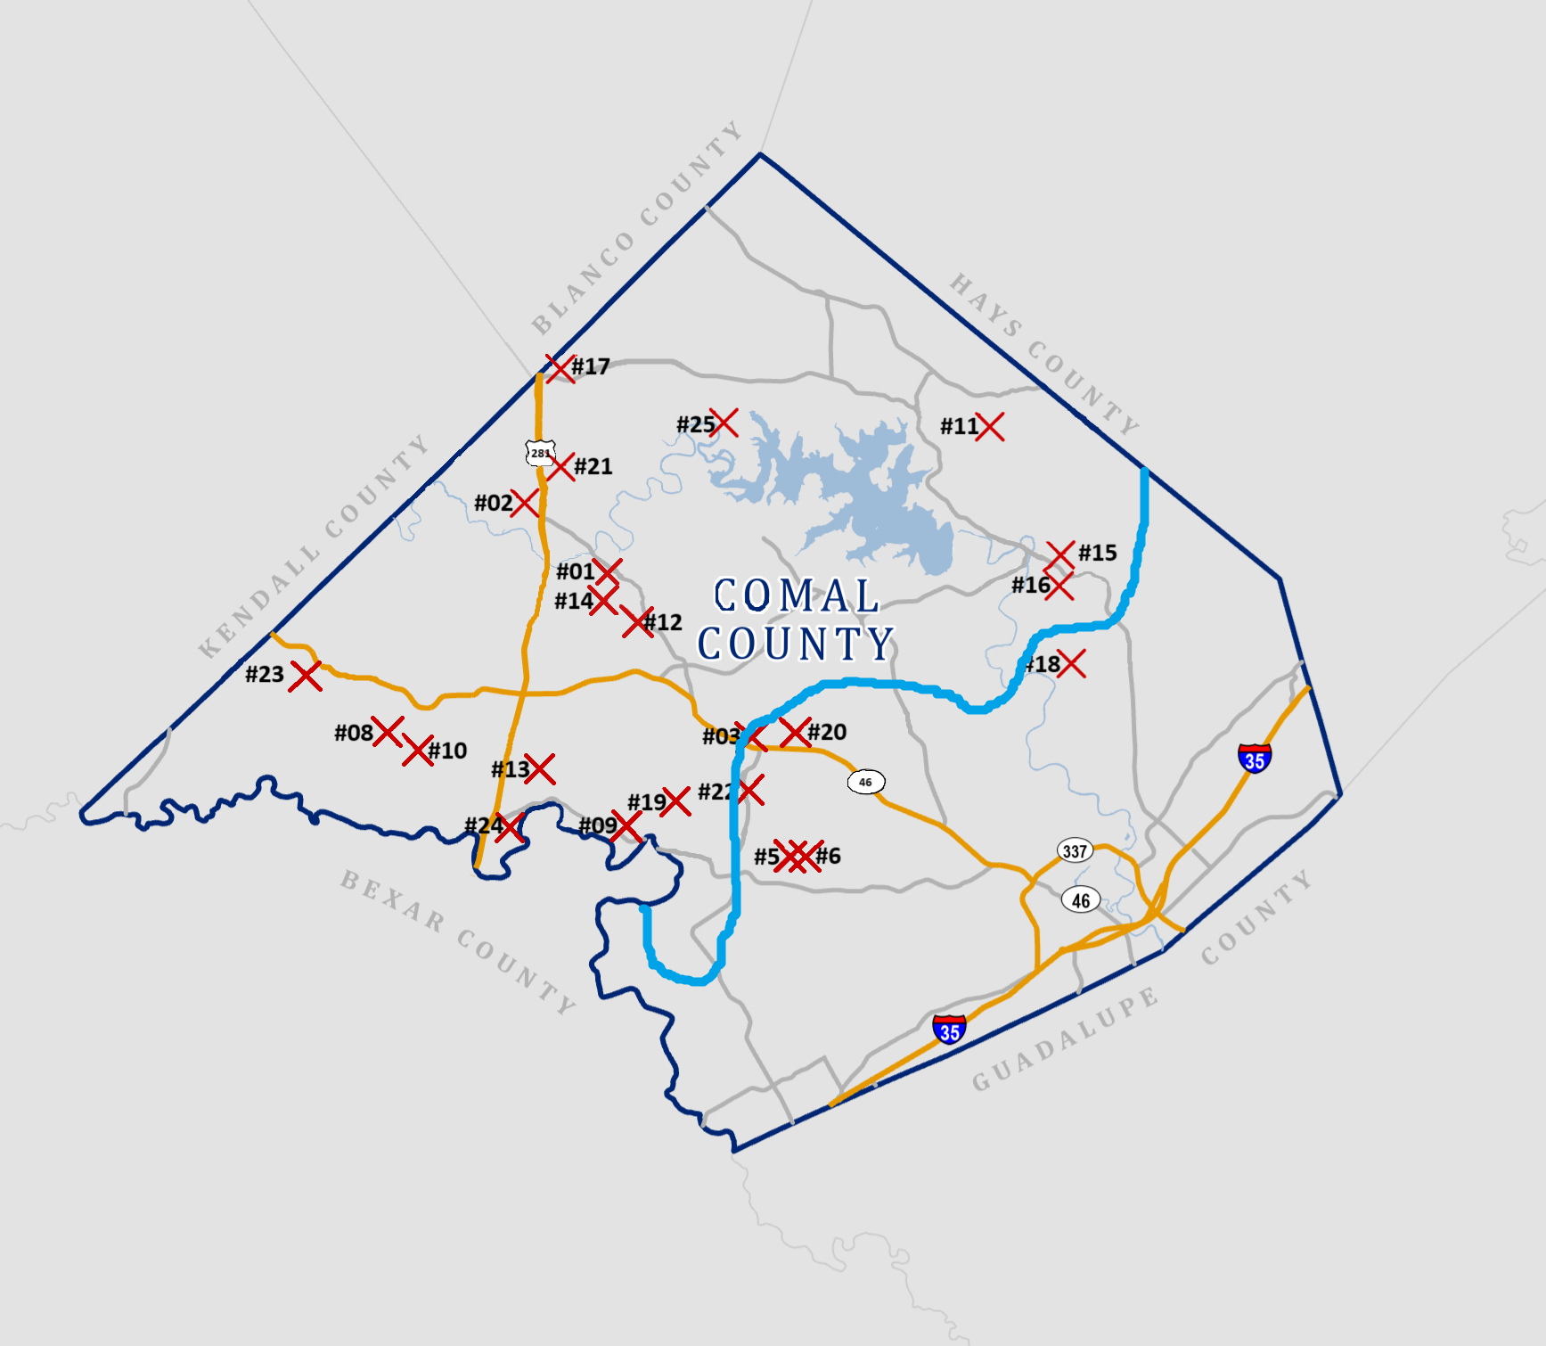
Groundwater Management Area #9
Groundwater Management Area #10

Slide 8
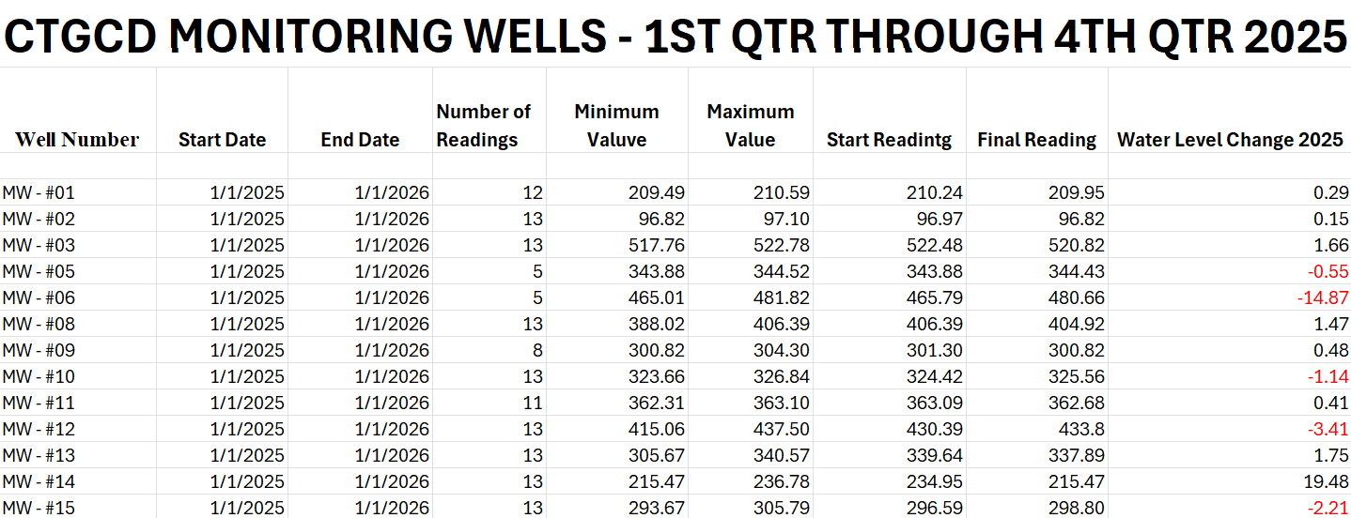

Slide 9
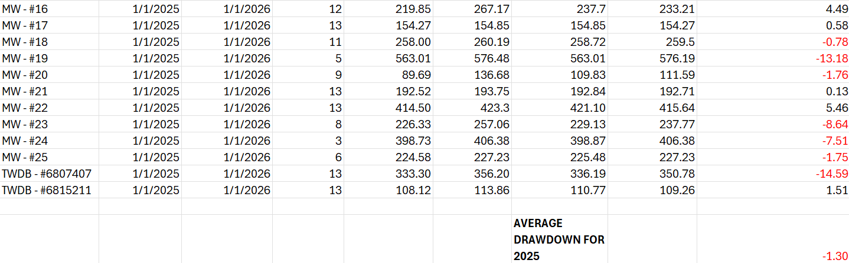
CTGCD MONITORING WELLS- 1stQTR THROUGH 4thQTR 2025

Slide 10
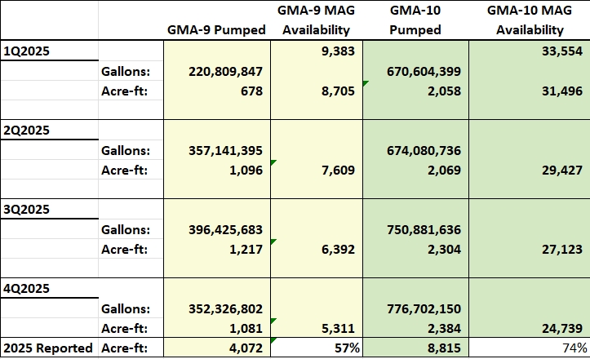

Slide 11

Well Applications By Type
Type of Application | 1st Quarter | 2nd Quarter | 3rd Quarter | 4th Quarter | Total for Year | GMA 9 | GMA10
a) Domestic | 32 | 17 | 22 | 24 | 95 | 79 | 16
a)S Livestock | 1 | 0 | 1 | 0 | 2 | 0 | 2
a)L Domestic Landscape Irrigation | 2 | 4 | 0 | 2 | 8 | 7 | 1
b) < 25,000 GPD (Non-exempt) | 3 | 1 | 1 | 0 | 5 | 3 | 2
c) > 25,000 GPD (Non-exempt) | 0 | 0 | 0 | 0 | 0 | 0 | 0
d) Plugging | 3 | 2 | 4 | 5 | 14 | 5 | 9
e) Test Bore | 0 | 5 | 1 | 6 | 6 | 4 | 2
f) Completion of test < 25,000 GPD | 0 | 0 | 0 | 0 | 0 | 0 | 0
g) Completion of test > 25,000 GPD | 0 | 0 | 1 | 0 | 1 | 0 | 1
Geothermal | 0 | 0 | 0 | 0 | 0 | 0 | 0
Monitor well | 0 | 0 | 0 | 0 | 0 | 0 | 0

Slide 12
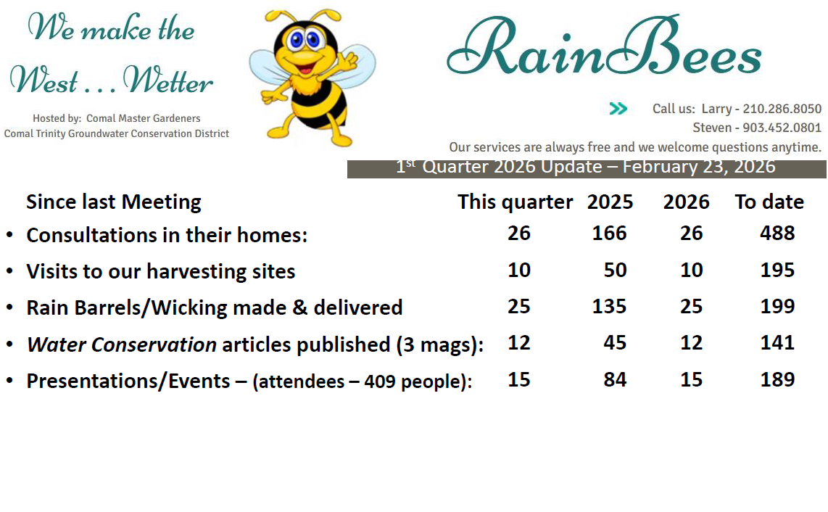

Slide 13
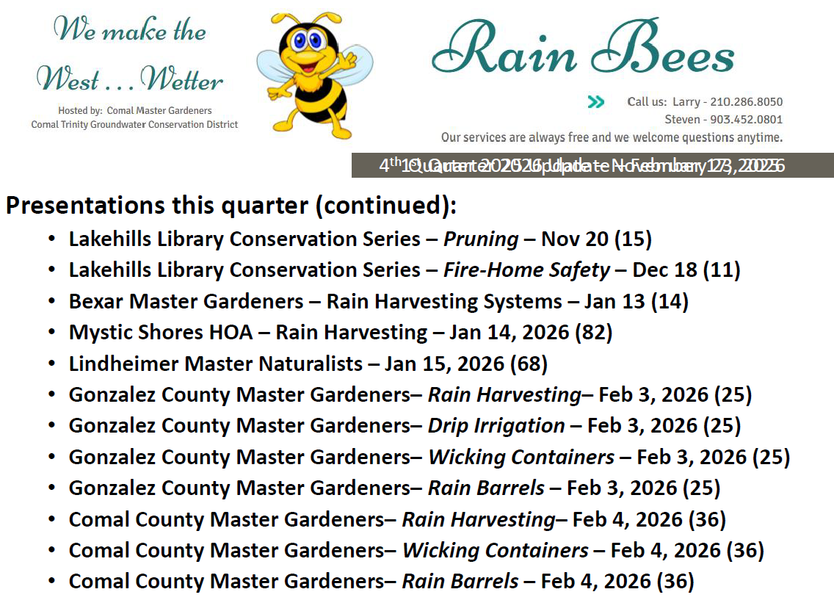

Slide 14
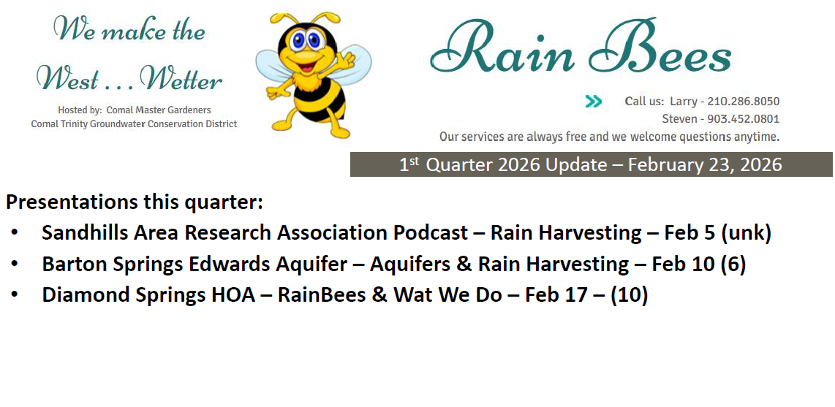

Slide 15
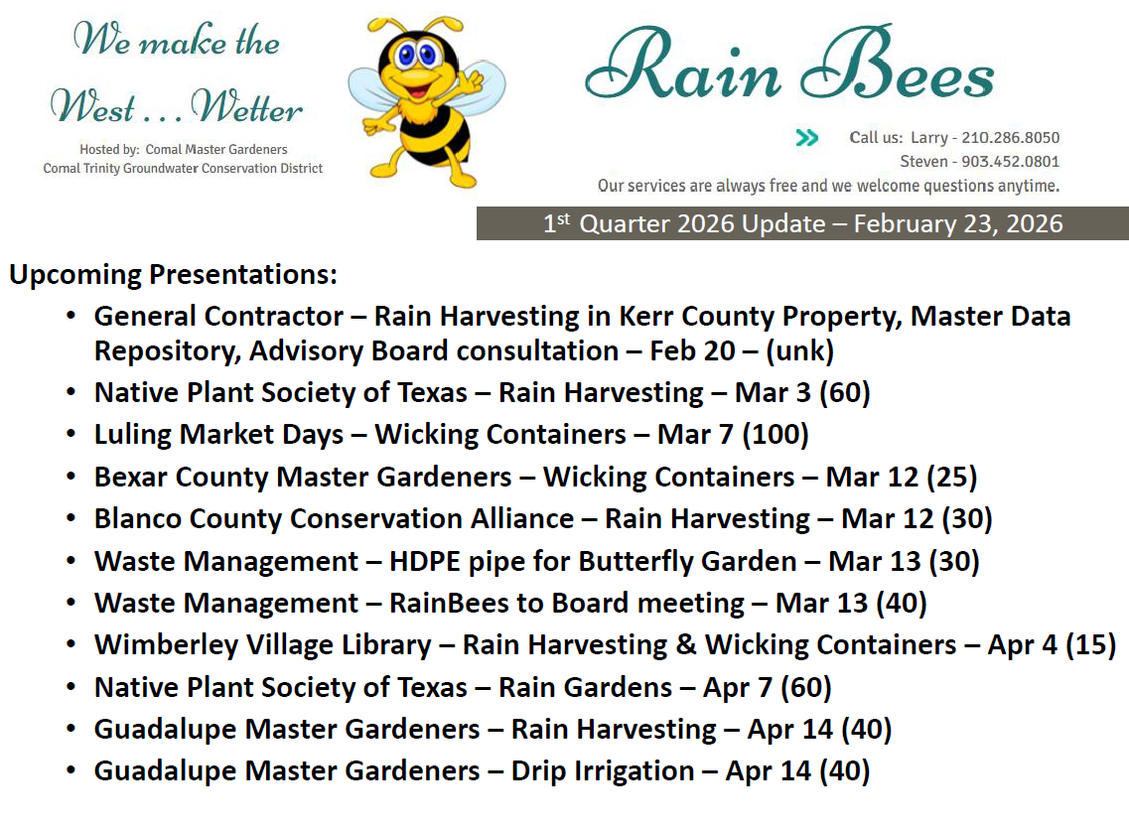

Slide 16
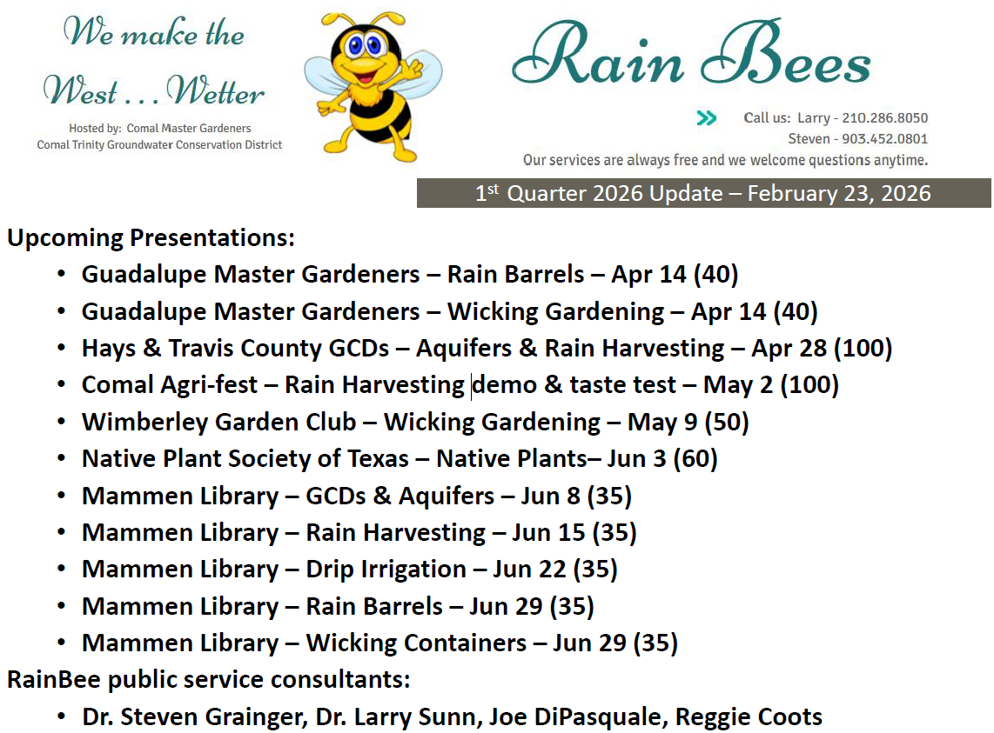

Slide 17
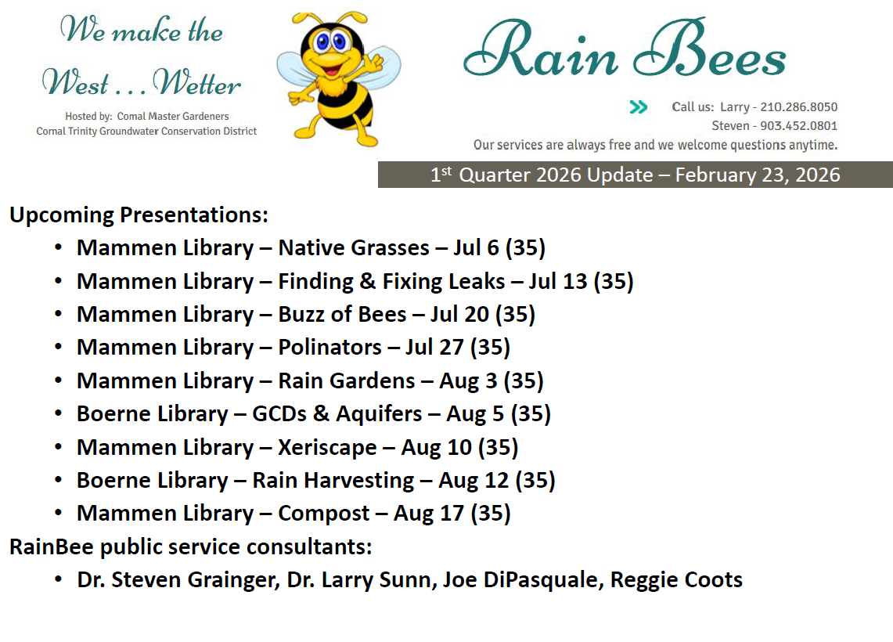

Slide 18
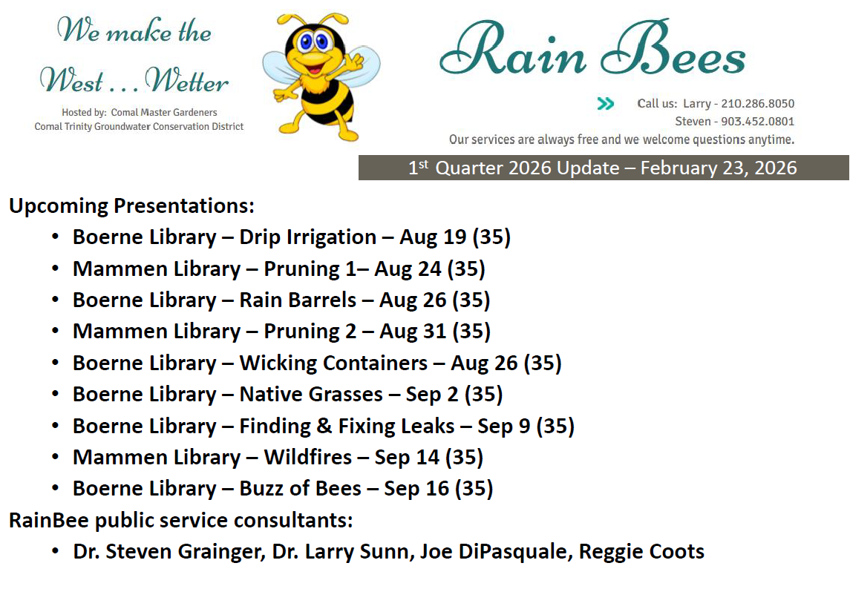

Slide 19
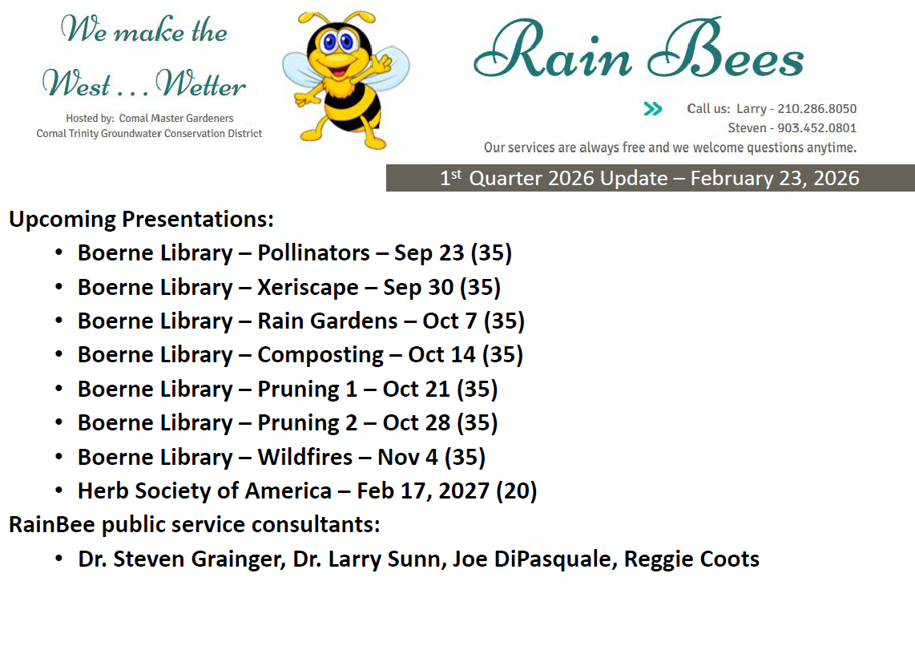

Slide 20
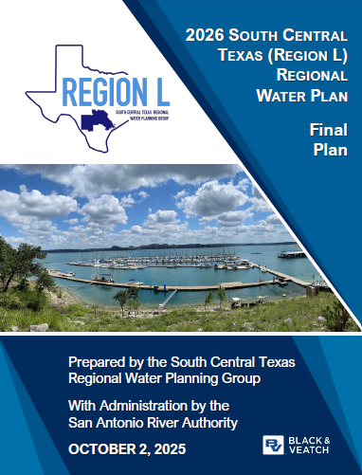

Slide 21
