Slide 1

Comal Trinity
Groundwater Conservation District
General Manager Report
August 18th 2025

Slide 2
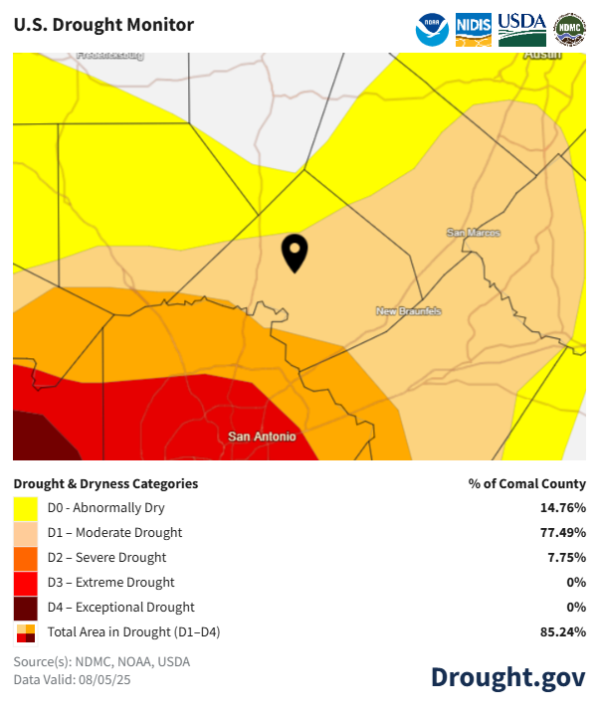
Comal County Drought Information-August 2025
Comal County Drought Information- August 2025

Slide 3
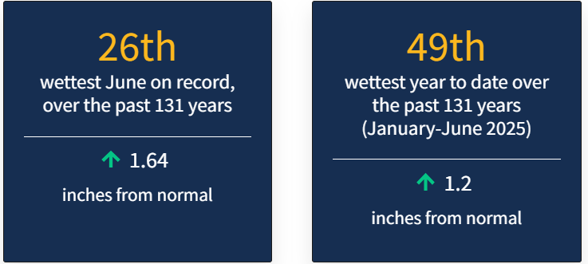
Comal County Drought Statistics June 2025

Slide 4
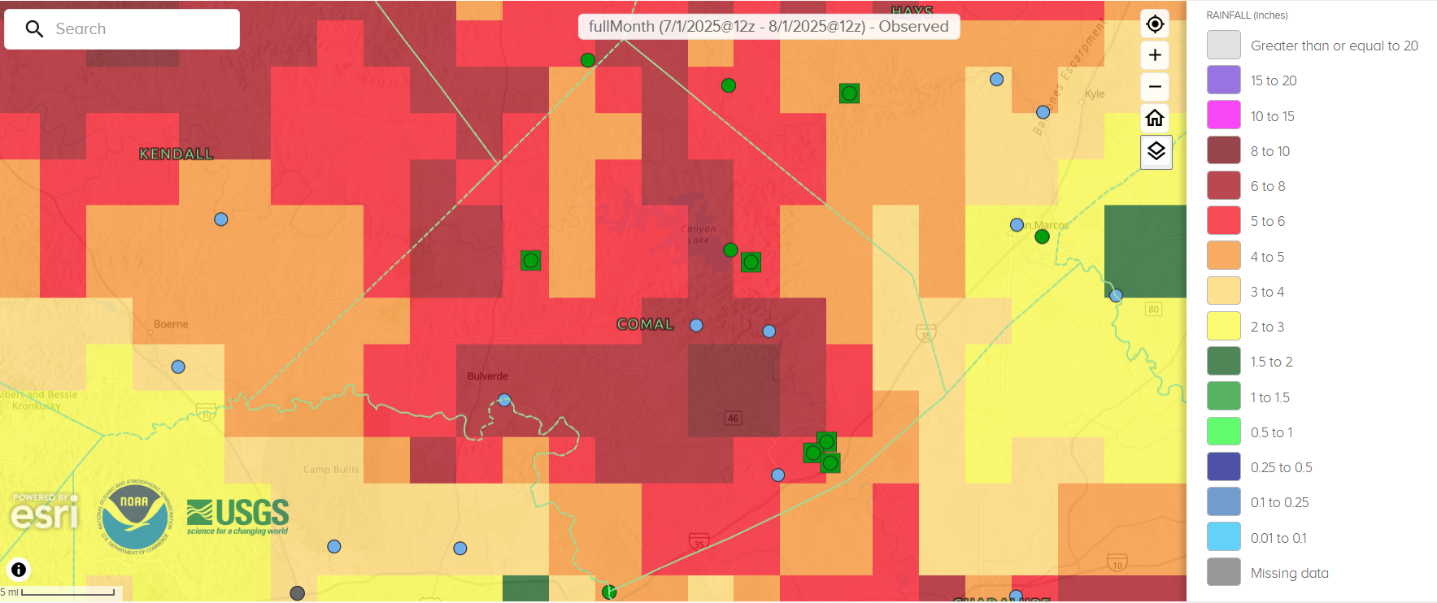
30 Day Observed Precipitation
7/1/2025 – 8/1/2025
3.0 to 10.0 Inches

Slide 5
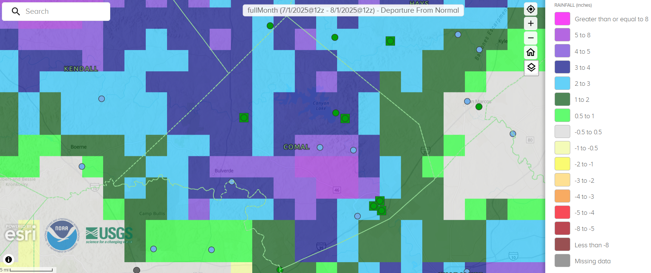
30 Day Precipitation Departure From Normal
7/1/2025 – 8/1/2025
0.5 to Greater than or Equal to 8.0 Inches

Slide 6
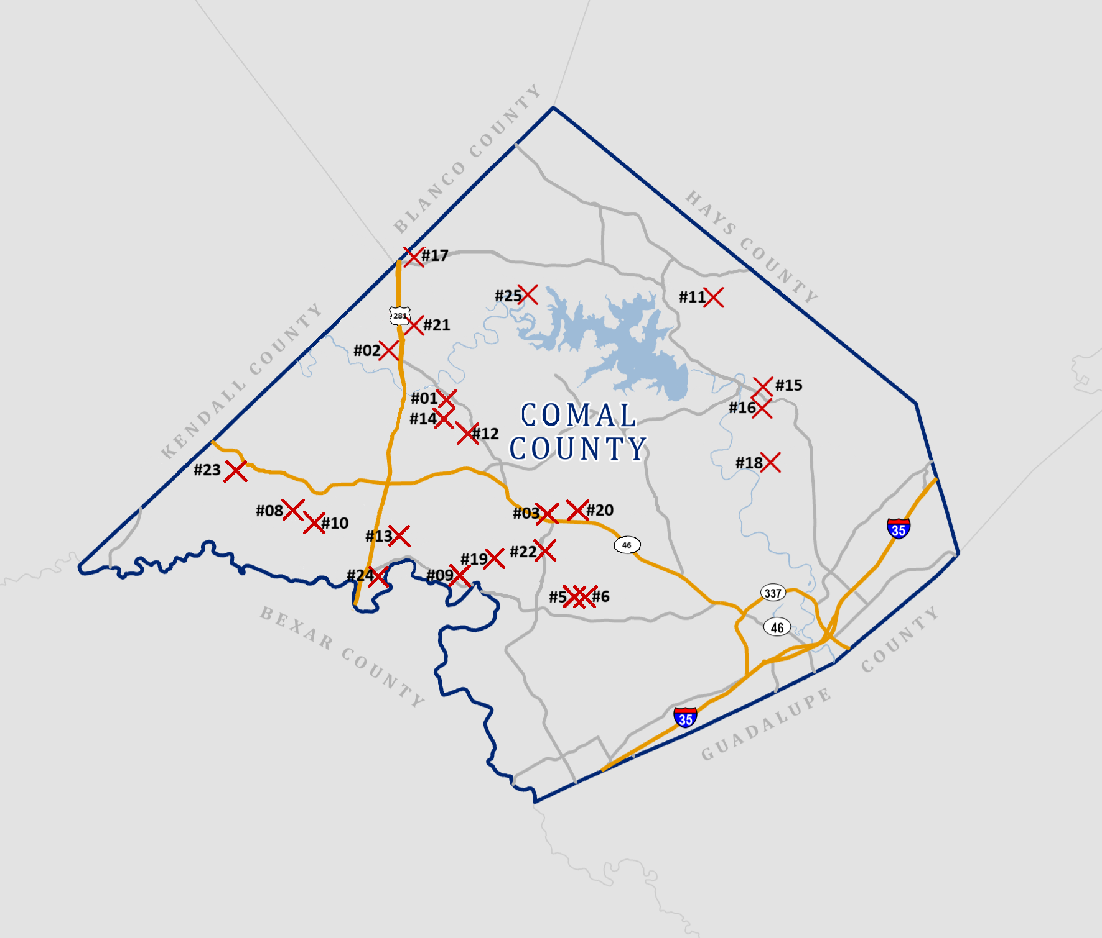

Slide 7
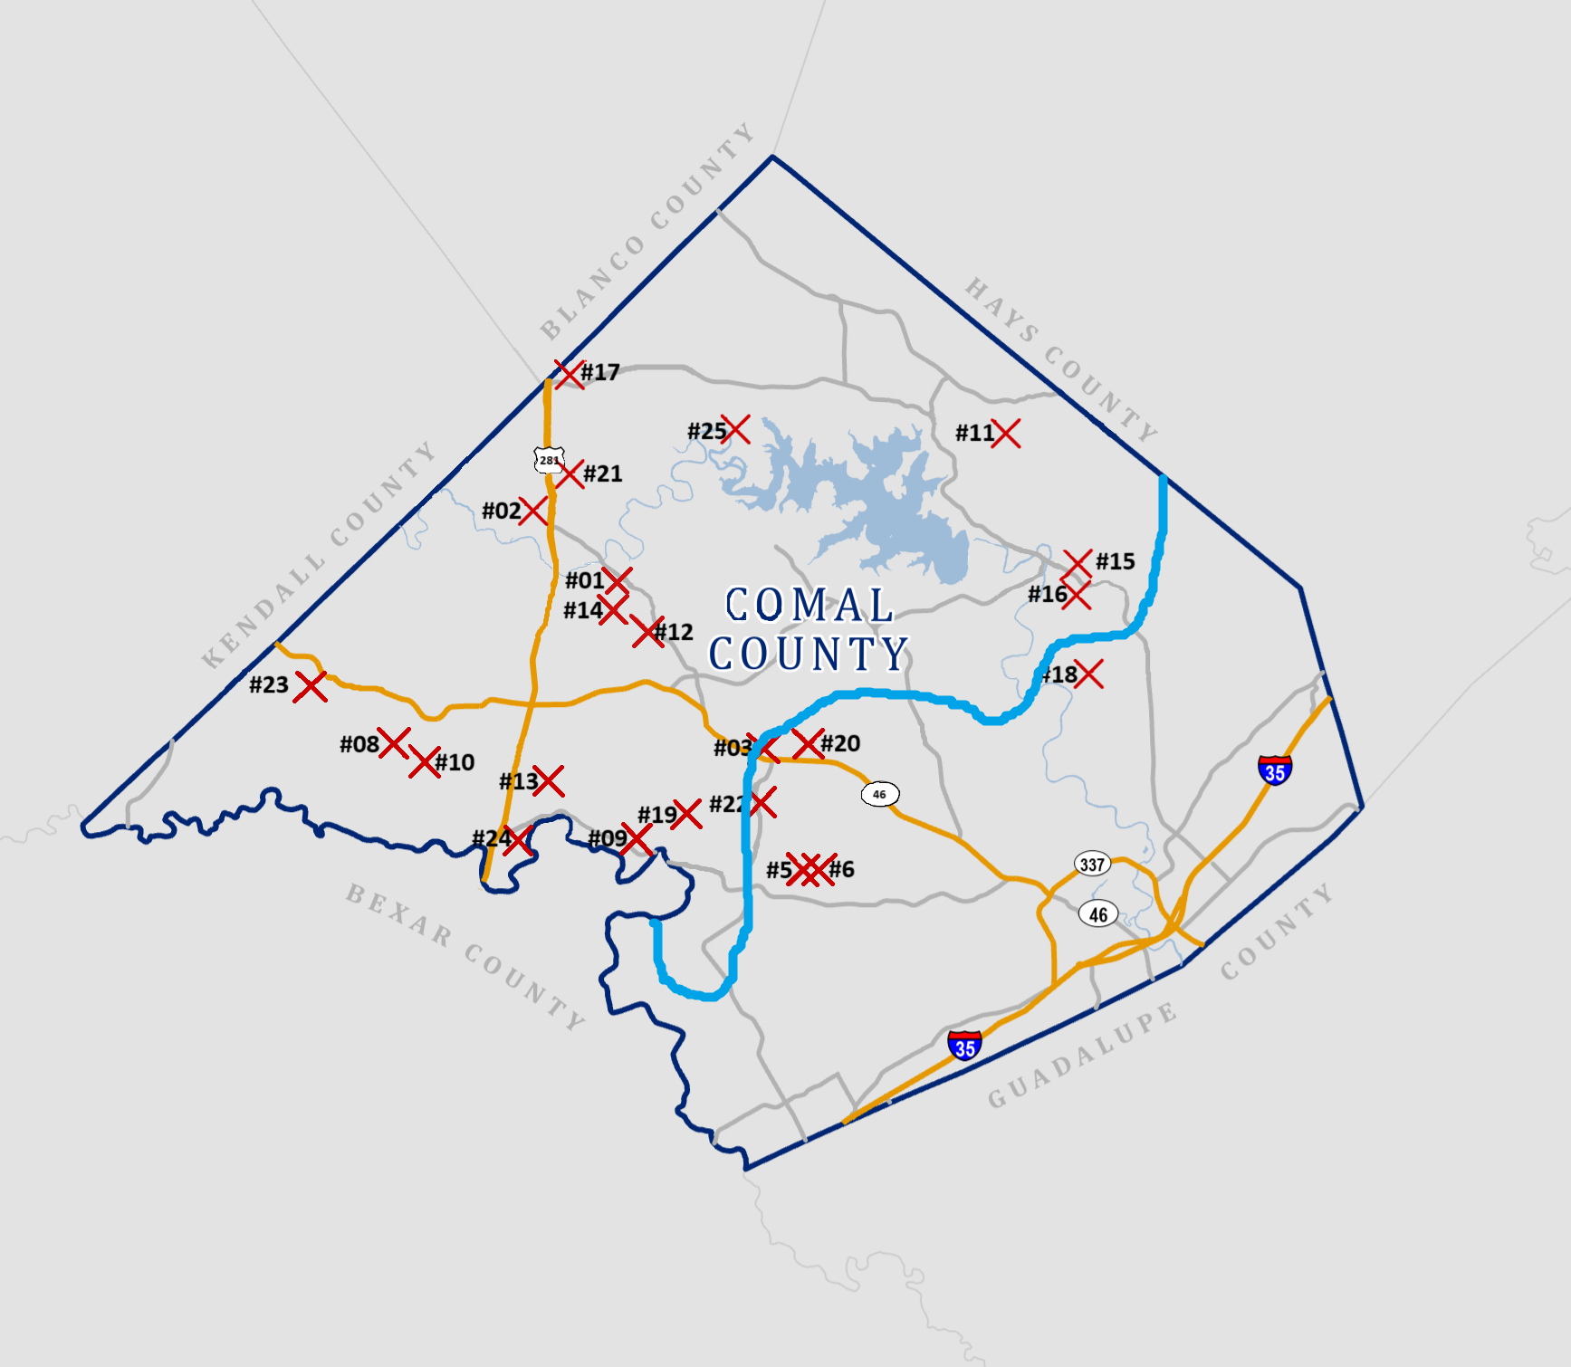
Groundwater Management Area #9
Groundwater Management Area #10

Slide 8
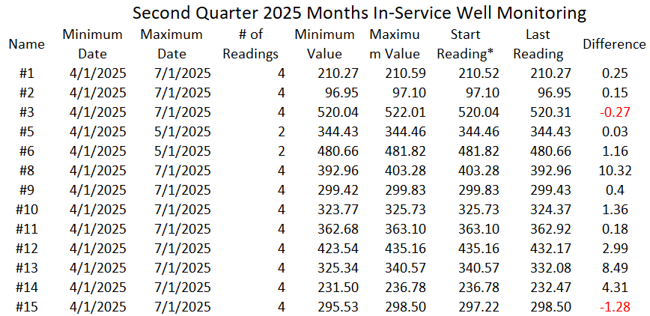

Slide 9
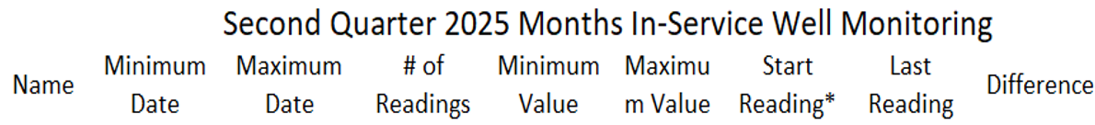
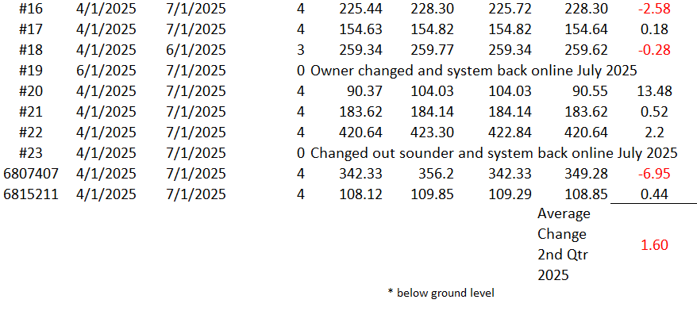



1.60

Slide 10
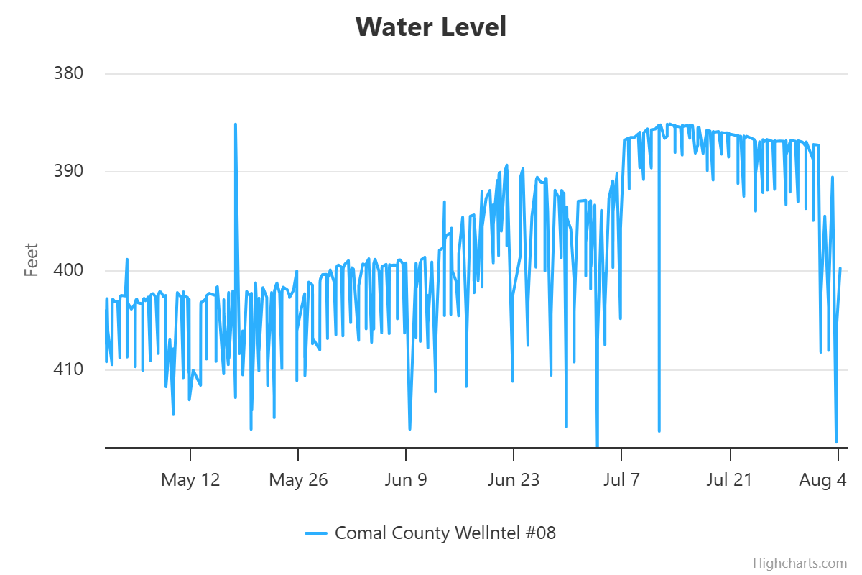
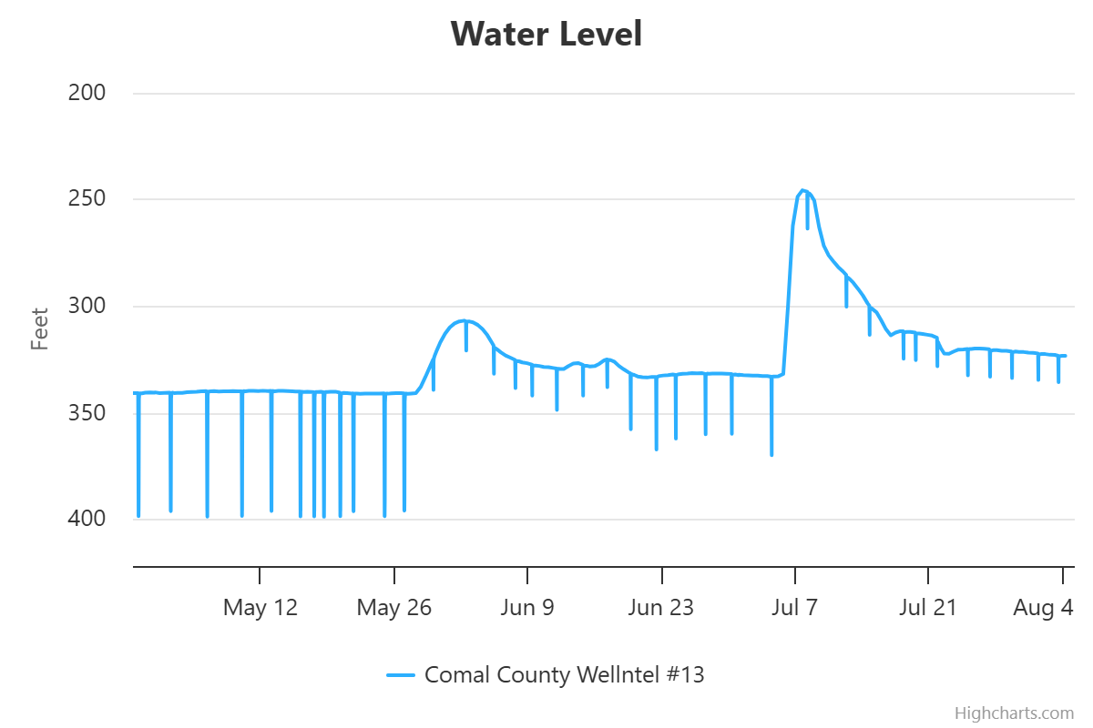
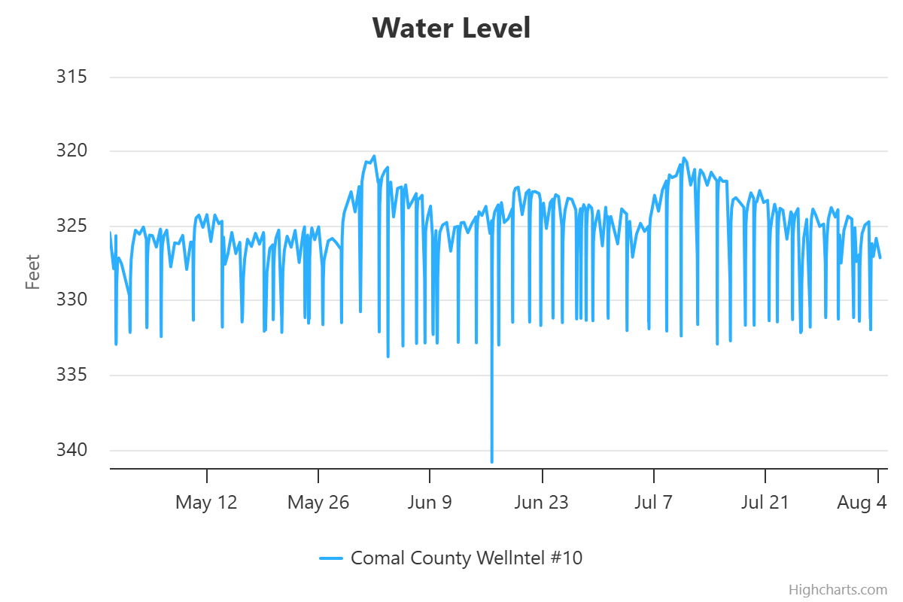





Bulverde Area Monitoring Wells
Bulverde Area Wells

Slide 11
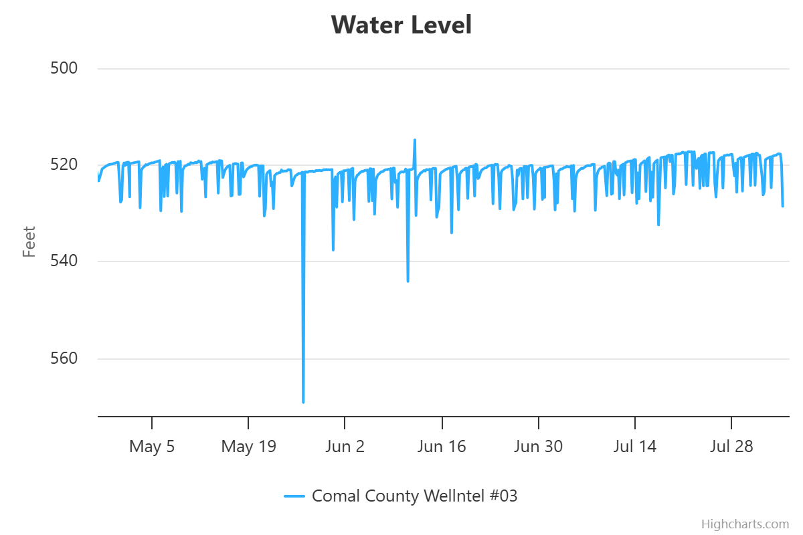
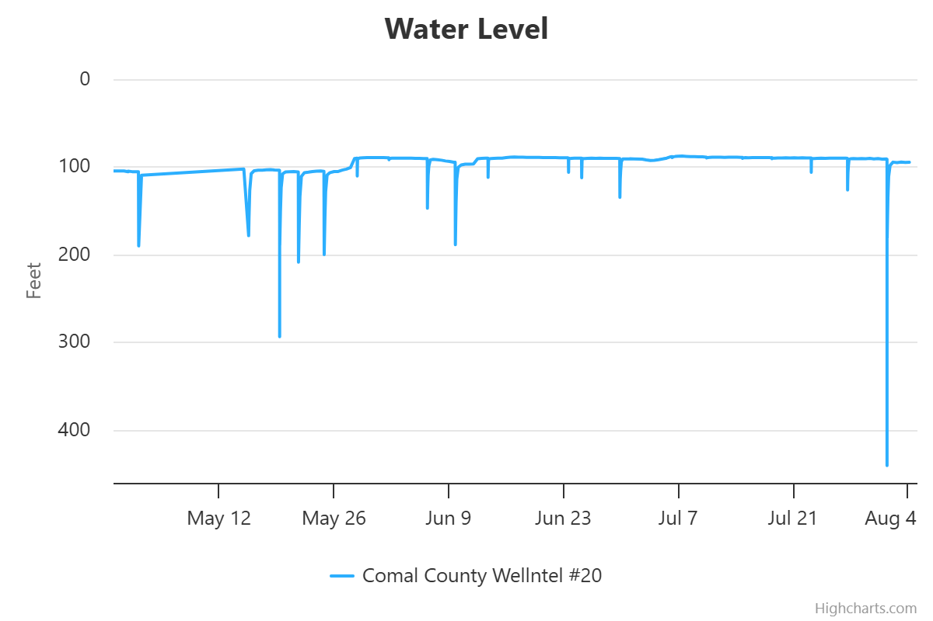
New Braunfels Area Monitoring Wells

Slide 12
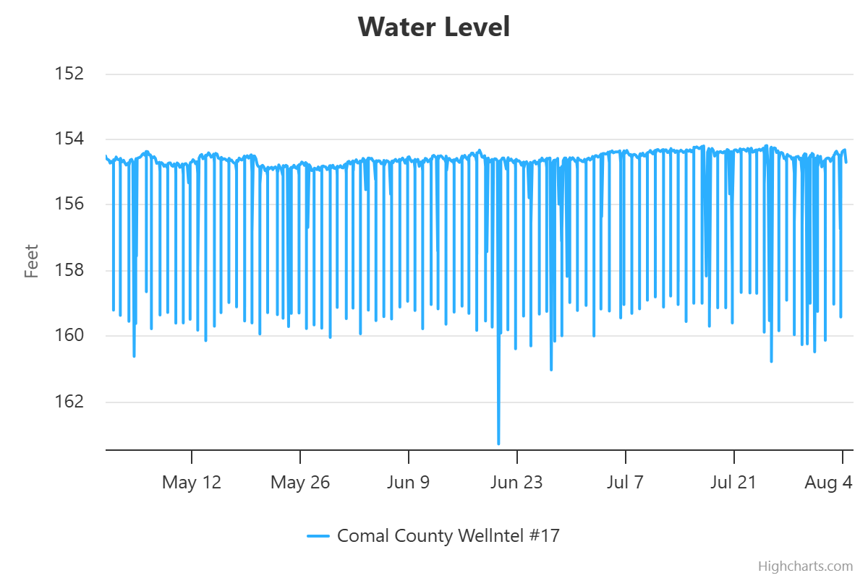
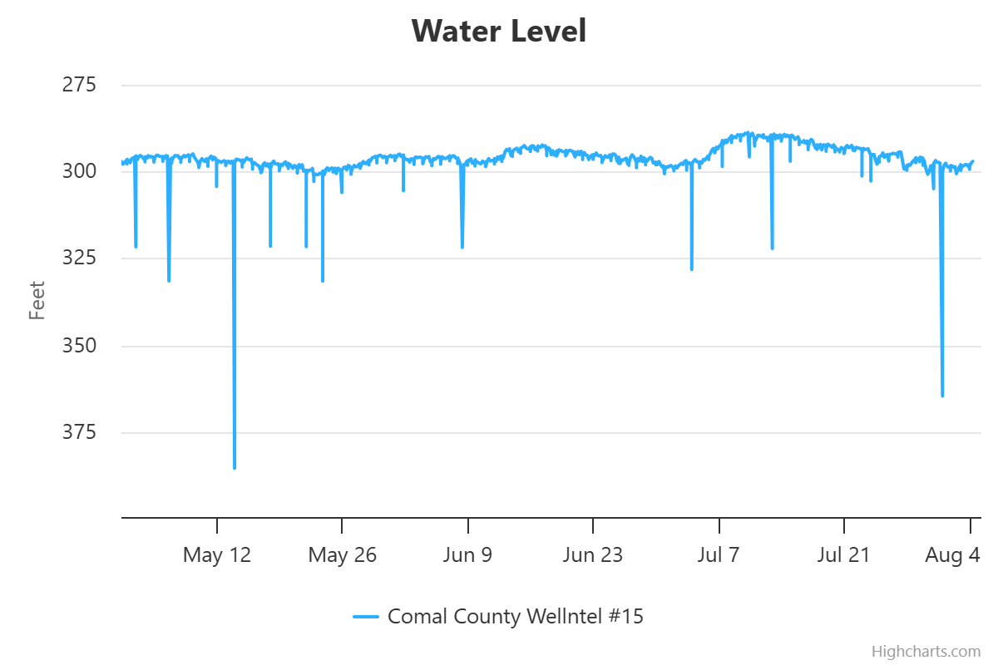
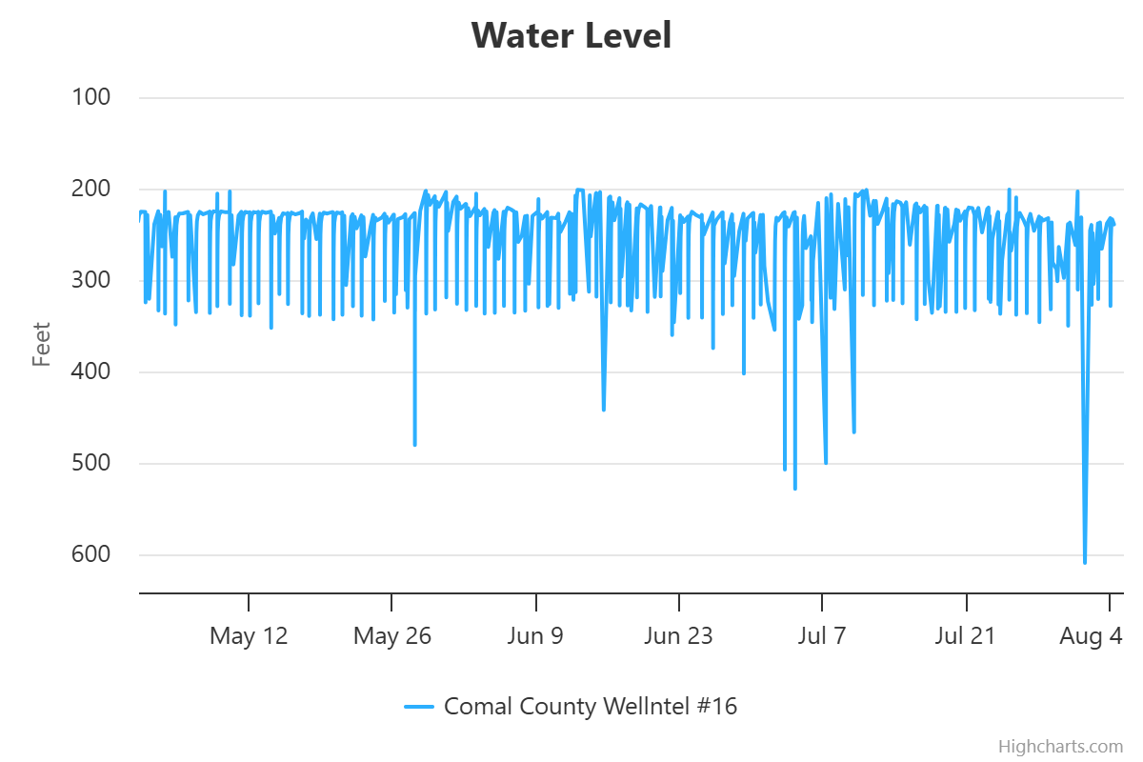
Canyon Lake Area Monitoring Wells

Slide 13
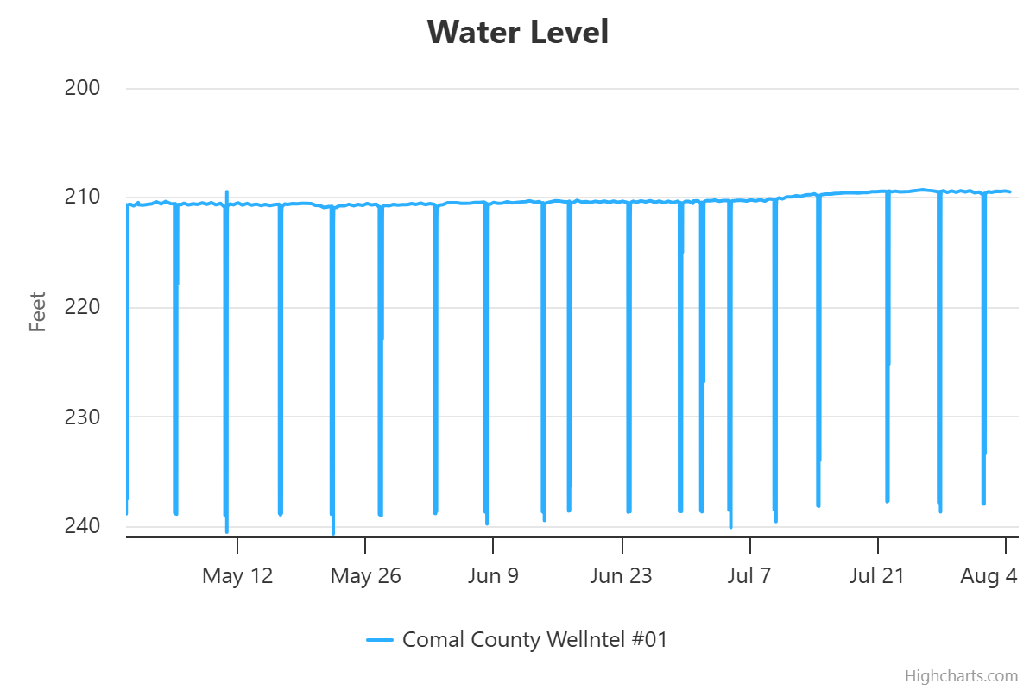
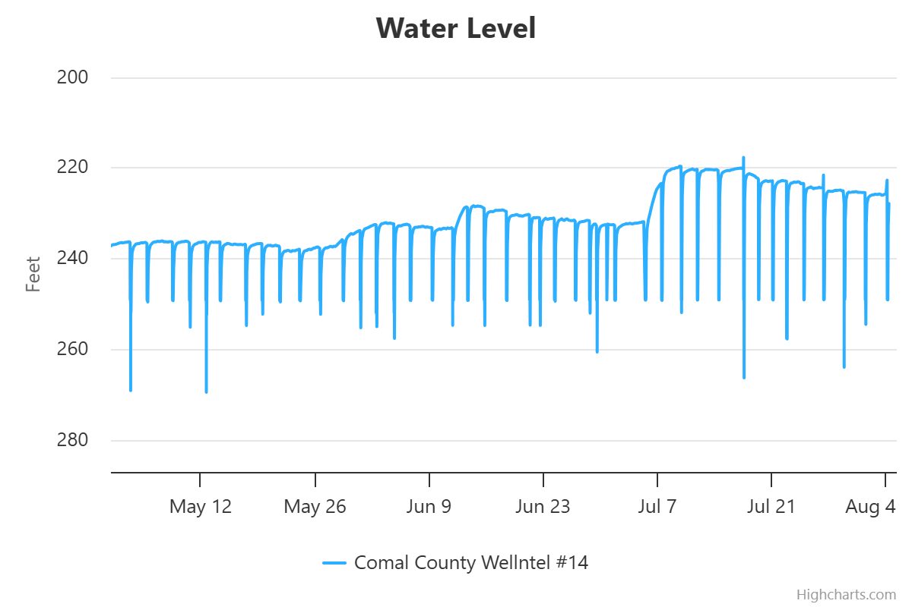
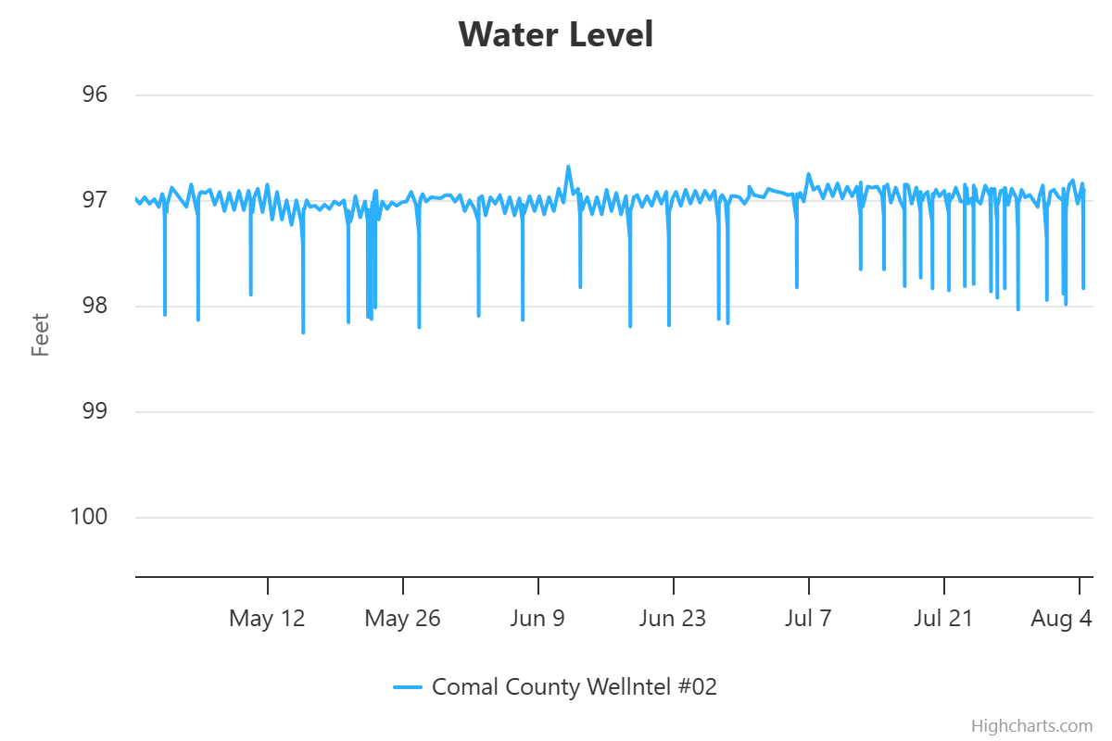
Spring Branch Area Monitoring Wells

Slide 14
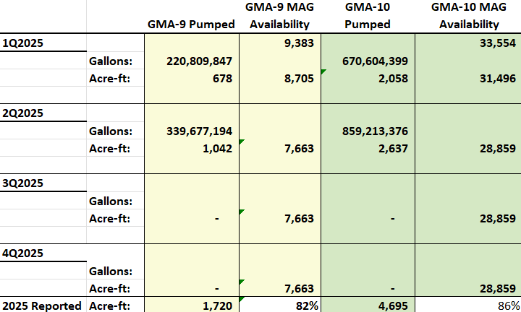
86%

Slide 15

Well Applications By Type 2nd Qtr 2025
Type of Application | 1st Quarter | 2nd Quarter | 3rd Quarter | 4th Quarter | Total for Year | GMA 9 | GMA10
a) Domestic | 32 | 17 |  |  | 49 | 42 | 7
a)S Livestock | 1 | 0 |  |  | 1 | 0 | 1
a)L Domestic Landscape Irrigation | 2 | 4 |  |  | 6 | 5 | 1
b) < 25,000 GPD (Non-exempt) | 3 | 1 |  |  | 4 | 2 | 2
c) > 25,000 GPD (Non-exempt) | 0 | 0 |  |  | 0
d) Plugging | 3 | 2 |  |  | 5 | 2 | 3
e) Test Bore | 0 | 5 |  |  | 5 | 4 | 1
f) Completion of test < 25,000 GPD | 0 | 0 |  |  | 0
g) Completion of test > 25,000 GPD | 0 | 0 |  |  | 0
Geothermal | 0 | 0 |  |  | 0
Monitor well | 0 | 0 |  |  | 0

Slide 16
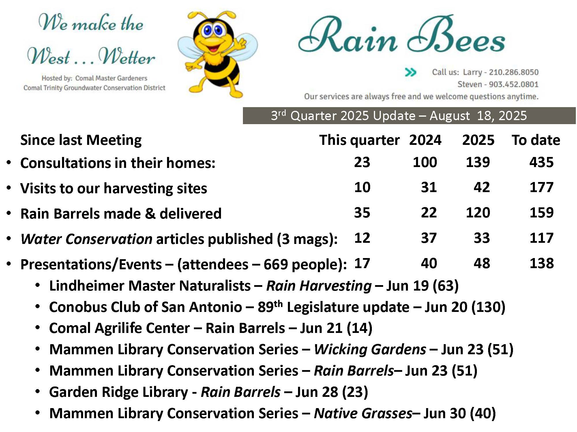

Slide 17
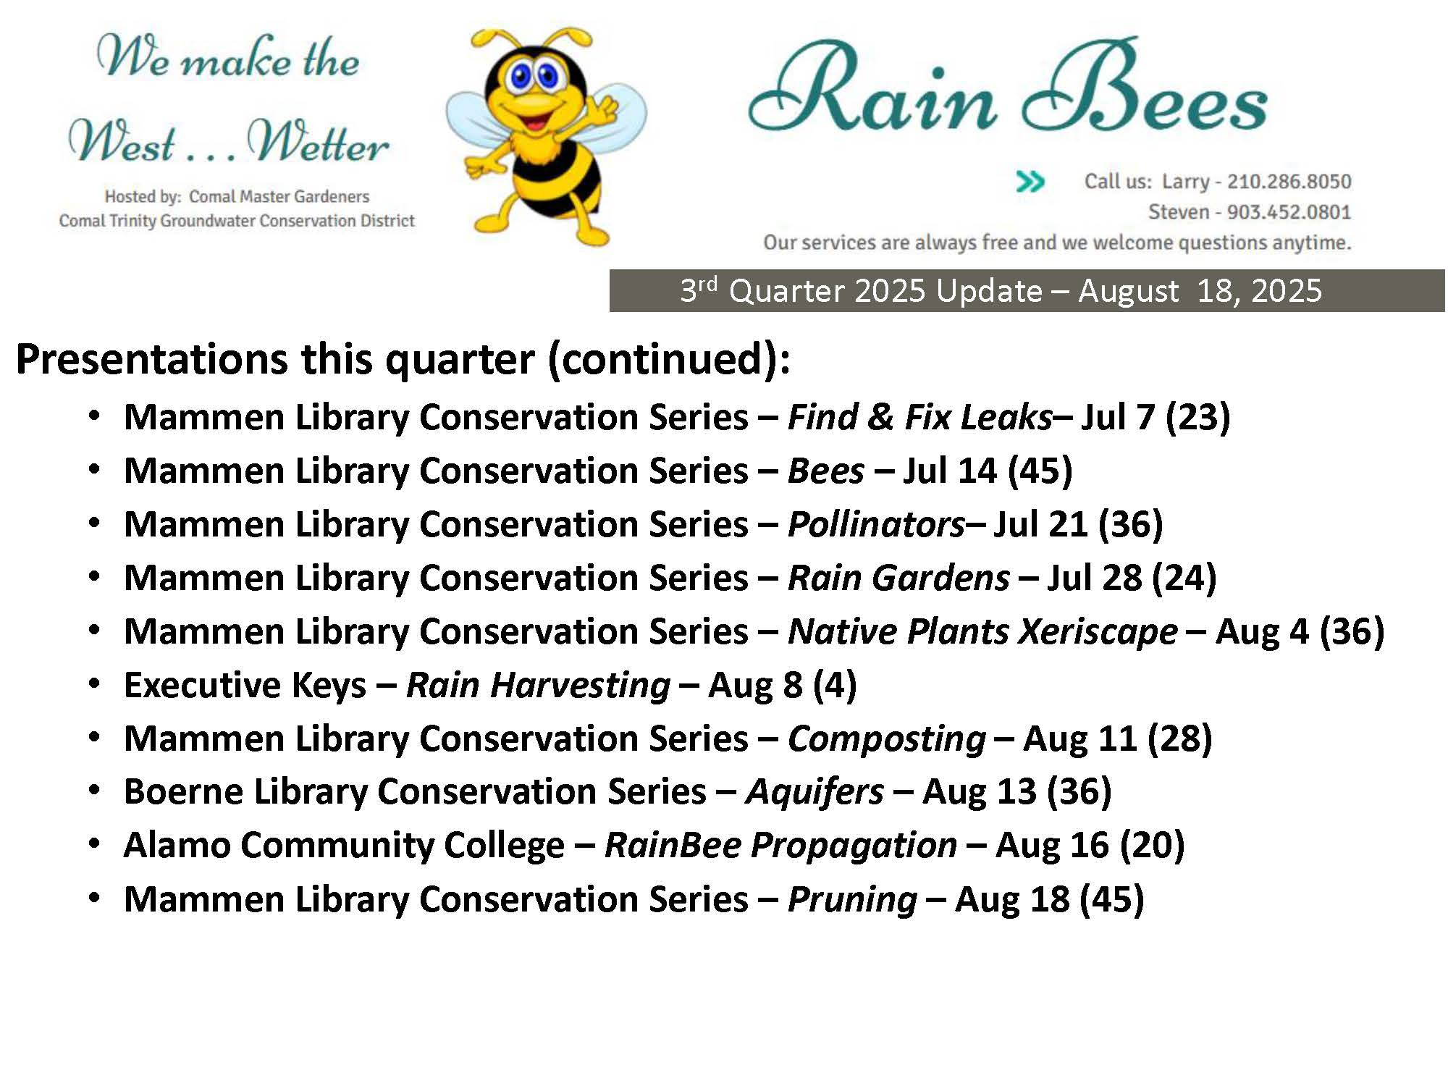

Slide 18
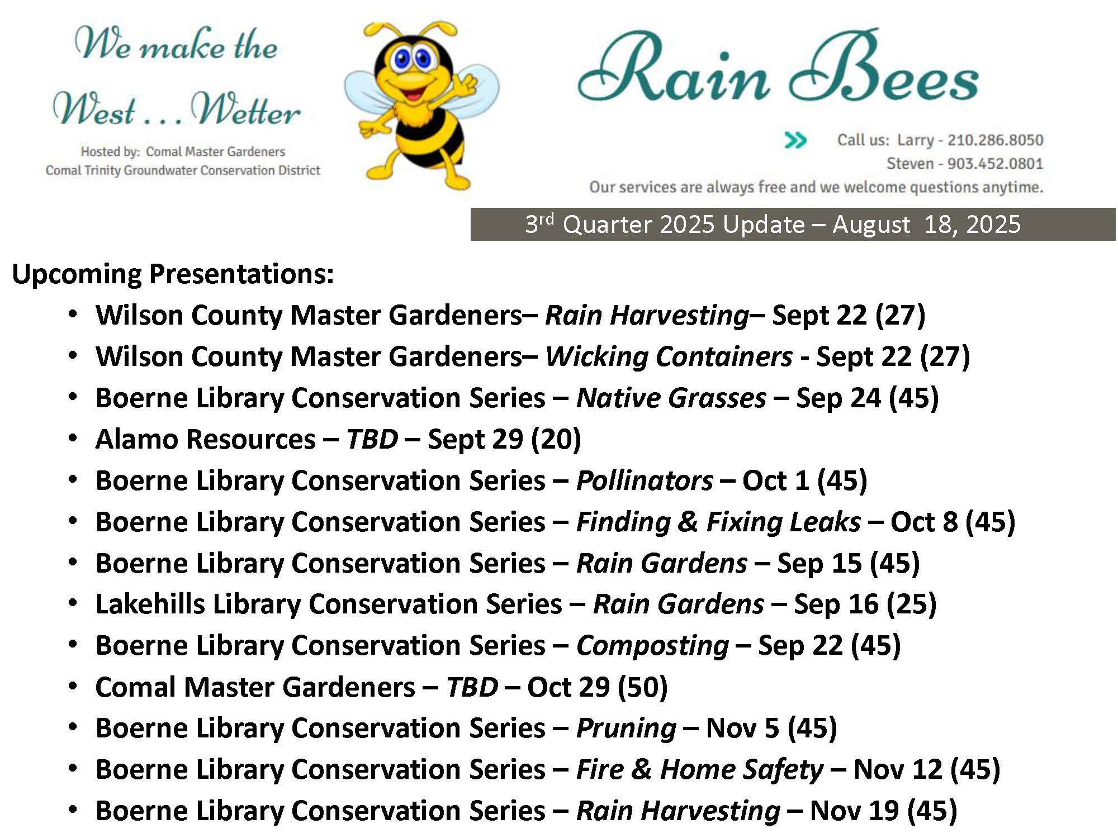

Slide 19
